Slide 1
HIPAA
Training
Frederick County Fire and Rescue Department

Slide 2

What is HIPAA??
HIPAA = Health Insurance Portability and Accountability Act. Federal Law that was passed in 1996.
Created by – United States Department of Health and Human Services (DHHS)

Slide 3

Still not clear??
HIPAA is a common set of standards that protects certain health information.
There are several components – but, we are most concerned with the “Privacy Rule.”

Slide 4

The Privacy Rule
The intent of the Privacy Rule is to provide basic rights regarding the use of “Protected Health Information” (PHI).
It protects all “individually identifiable health information.”
Electronic, paper, or oral.
Applies to “covered entities.”

Slide 5
Who is a Covered Entity?
Three Categories:
Health plans.
Health care clearing houses.
Health care providers who transmit any health information electronically.
FCFRD falls under the
Health Care Provider category!

Slide 6

What’s Required?
The Privacy Rule requires Covered Entities to:
Protect PHI.
Designate a Privacy Officer.
Look for “leaks” in the policy.
Conduct/document training for the ENTIRE Department.
Develop an Authorization Form for release of PHI.

Slide 7
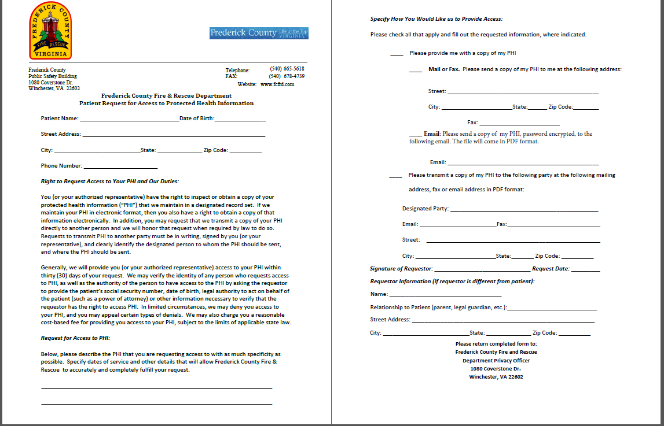
FCFRD PHI Request form found on our website at www.fcfrd.com

Slide 8
More Requirements
Develop a Notice of Privacy Practices
When permitted, always disclose only the minimum necessary PHI
Update policies and procedures
Identify Business Associates and create contracts
Apply reasonable administrative, technical, and physical safeguards

Slide 9

Privacy Officer
An individual within the organization that is responsible for developing and implementing policies and procedures required by HIPAA.
Frederick County Fire and Rescue Department’s Privacy Officer is EMS Billing Manager Christine Bauserman.

Slide 10

Protected Health Information
PHI is any information created or received by a health care provider which relates to:
Past, present, or future physical or mental conditions.
Provision of health care.
Past, present, or future payment for care.

Slide 11

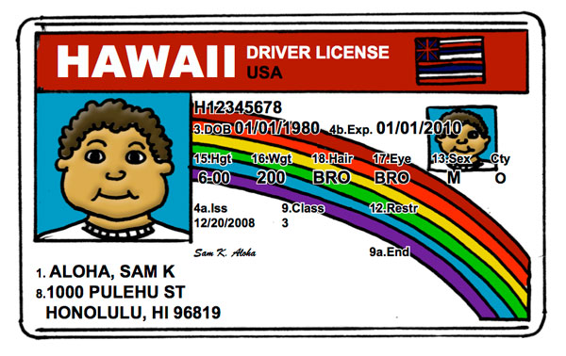
Examples of PHI
Name
Address
Date of Birth / Age
Social Security Number
Scene pictures that include license plates
Medical condition / past medical history
Full face photos

Slide 12

HIPAA should NEVER negatively impact the quality of patient care or impede the ability to provide care!!
The appropriate communication of PHI with other health care providers directly involved in providing patient care does not constitute a violation of HIPAA.
Keep in mind Minimum Necessary! Broadcasting a patient’s communicable disease could be a violation. Instead of stating patient’s disease remind others to use universal precautions.

Slide 13

Safeguarding PHI
PCR’s should be kept in a secure location.
Always log out of your reporting software before walking away from your tablet or computer.
Networks containing PCR’s should be password-protected with user specific logins.
Generic logins allow for anonymous access to PHI and set up the Department for liability.
Include confidentiality statements on e-mails and faxes that contain PHI.
Never allow someone else to use your
  login information.

Slide 14

Use Caution…
Beware of discussion of PHI, such as:
Talking about current or prior incident(s) while re-stocking ambulance or typing your report at the ER.
Discussing a call anywhere other than an official audit or review.
Discussing “interesting” calls, famous patients, or neighbors.
Sharing a co-worker or fellow responder’s PHI.
Posting of scene photos on social media. Remember even off duty the public sees you as a representative of the Fire and Rescue Department.

Slide 15
Selfies and EMS
‘Selfie war’ paramedic sentenced to 6 months in jail
Christopher Wimmer and another EMS paramedic, Kayla Dubois, were investigated and charged last year after allegations surfaced the pair had compromising photos on their phones of patients inside ambulances who were under their care as part of an ongoing “selfie war.”
If a picture is need to show mechanism of injury than take it with your tablet/laptop. No pictures should ever be taken on your cell phone.

Slide 16
Calif. EMT sued after posting picture of patient’s injury
By EMS1 Staff
WALNUT CREEK, Calif. — An EMT is facing a civil lawsuit after posting a photo of a patient’s serious injury online.
Earlier this year, a 21-year-old man, who identified himself as Keyano, had one of his legs amputated in a motorcycle crash that nearly killed him.
The EMT that transported him to the hospital posted a graphic photo of Keyano’s leg on Instagram, captioned, “This is what happens when you’re careless in the rain on a motorcycle.” The post also included the hashtags #byebyeankle and #thelouderyouscreamthefasterwego.
The photo was deleted several days later, and the EMT wrote a public apology to Keyano and his family via social media, reported CBS San Francisco.
“When you’re an EMT, don’t you abide by the laws and regulations?” Keyano’s mother asked. “What were you thinking?”
Since the photo was taken inside a hospital by a medical provider, it is likely that privacy laws will come into play.

Slide 17
PPCR Copies
Who should get a copy of my patient’s PPCR?
  Personnel not directly involved in patient care, QA, or billing are not permitted access to the patients PPCR.
For example:
  If I transport in a ambulance from a different agency but no representatives from that agency rides on the call then they are not covered and can not obtain that patient’s PPCR.

Slide 18

Unsure About Discussing an Incident??
Ask yourself…
Would a Judge agree that the disclosure benefited patient care AND was performed with the utmost discretion???
If you were the patient, would you want an “embarrassing” injury or illness to be discussed?

Slide 19
Notice of Privacy Practices
(NPP)
The Department must make a Good Faith attempt to provide a NPP to each patient.
You are required by law to offer the NPP to each patient. You may also tell them it is available on our website.
They don’t have to take it but you have to offer it.
The Department must also make an effort to get a signed “Acknowledgement of Receipt.”

Slide 20
Notice of Privacy Practices
Any department that charges for service needs to give a NPP to every patient that is transported, including a signature form which acknowledges receipt and permission to bill insurance on the patient’s behalf.
Every career and volunteer member of the Department must review and be familiar with this material.
An example can be viewed on the next two slides.
The NPP is also available on the internet at www.fcfrd.com.

Slide 21
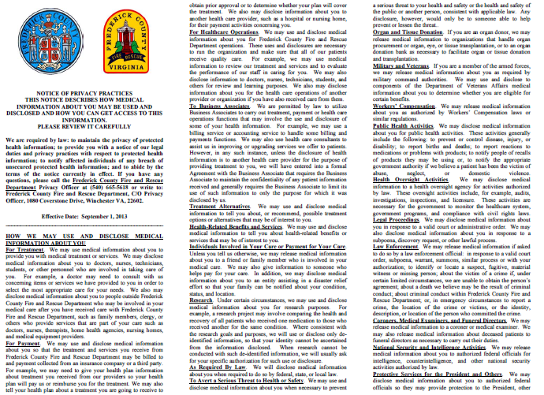

Slide 22
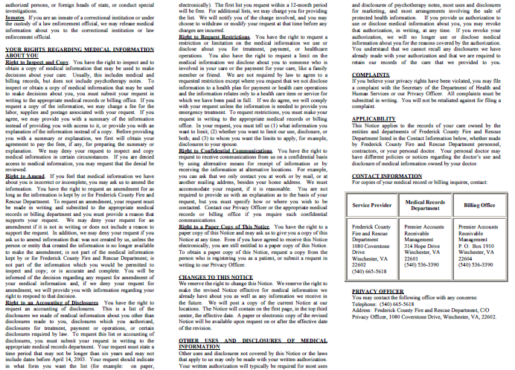

Slide 23
NPP in Emergency Settings
During the emergency treatment of a patient, the NPP must be given as soon as practical as detailed in 45 CFR 164.520 of the privacy rule.
Providers may provide this information after the transfer of patient care at the receiving facility.
This ensures that the provision of this information does not interfere with patient care or become lost during the emergent phase of treatment. If after transfer of care it is still not feasible to present the patient with the NPP, then the EMS Provider may leave it with the assigned nurse to present when it is feasible.

Slide 24

Permitted Disclosures
Disclosure of PHI is acceptable in the following circumstances:
Treatment
Payment
Operations
Public Health Regulations
Victims of Abuse
Judicial Proceedings
Law Enforcement
Births and Deaths
Research
Protection of Public Safety

Slide 25
Treatment, Payment, and Operations
Treatment – giving PHI to other providers involved in patient care, such as the hospital.
Payment – receiving PHI from other providers, as necessary for billing.
Operations – audits, quality assurance assessments.

Slide 26
Public Health Activities
Disclosures to public health authorities, as authorized by State Law.
Also allows for notification of communicable diseases to EMS providers involved in an exposure.

Slide 27
Victims of Abuse, Neglect, and Domestic Violence
The law requires (and HIPAA allows):
Reporting an “endangered adult” believed to be a victim of battery, neglect, or exploitation to Adult Protective Services or law enforcement.
Reporting a child that is believed to be a victim of abuse or neglect to the immediate supervisor, Child Protective Services, or law enforcement.

Slide 28
Judicial Proceedings
Disclosure must only be made when a Judge or Grand Jury orders disclosure through a subpoena or warrant.
**A private attorney does not have the authority to order a Fire Department provider to discuss a case. If contacted by an attorney, always contact the your county’s law office for advice before proceeding.**

Slide 29
Law Enforcement
Disclosure of PHI to Law Enforcement is permitted when:
Required by law.
Ordered by a court.
Ordered by Administrative Subpoena.

Slide 30
Law Enforcement
When assisting the police to identify or locate a suspect, missing person, or witness, the provider may release:
Name / Address
Date / Place of Birth
Social Security #
Blood Type
Date / Time of Treatment
Distinguishing characteristics – height, weight, tattoos, scars, etc…

Slide 31
Law Enforcement
Decedents
In the Commonwealth of Virginia local law enforcement is required to respond to any unattended death and will conduct an investigation.
You may request Law Enforcement anytime you feel an attended death is “suspicious” in nature.
You may release PHI to alert law enforcement of a patient’s death, IF the death may have resulted from criminal activity.
You are not required to make a “legal conclusion” that the death resulted from a crime.
Only a “suspicion” is required.
Note: there is a general exception for releasing PHI to coroners and funeral directors for non crime-related deaths.

Slide 32
Law Enforcement
As patient care advocates, EMS Providers
should encourage law enforcement to gain
information directly from the source, when
possible.

Slide 33
Civil Penalties
The U. S. Department of Health and Human Services may impose civil penalties on a covered entity for failure to comply with a Privacy Rule requirement.
HIPAA Violation | Minimum Penalty | Maximum Penalty
Unknowing | $100 per violation, with an annual maximum of $25,000 for repeat violations (Note: maximum that can be imposed by State Attorneys General regardless of the type of violation) | $50,000 per violation, with an annual maximum of $1.5 million
Reasonable Cause | $1,000 per violation, with an annual maximum of $100,000 for repeat violations | $50,000 per violation, with an annual maximum of $1.5 million
Willful neglect but violation is corrected within the required time period | $10,000 per violation, with an annual maximum of $250,000 for repeat violations | $50,000 per violation, with an annual maximum of $1.5 million
Willful neglect and is not corrected within required time period | $50,000 per violation, with an annual maximum of $1.5 million | $50,000 per violation, with an annual maximum of $1.5 million

Slide 34
Criminal Penalties
A person who knowingly obtains or discloses individually identifiable health information in violation of HIPAA faces a fine of $50,000 and up to one-year imprisonment.
The criminal penalties increase to $100,000 and up to five years imprisonment if the wrongful conduct involves false pretenses, and to $250,000 and up to ten years imprisonment if the wrongful conduct involves the intent to sell, transfer, or use individually identifiable health information for commercial advantage, personal gain, or malicious harm.
Criminal sanctions are enforced by the U. S. Department of Justice.
                Pub. L. 104-191; 42 U.S.C. §1320d-6.

Slide 35
HIPAA
Scenario One
You and your partner respond for a neighbor who suffers from depression. You discover during your assessment that the patient has had suicidal thoughts. After the call, you are concerned that other First Responders in your community need to know the extent of the patient’s illness so they can watch for warning signs should the depression deepen.
Can you share what you have learned with you fellow First Responders?

Slide 36
Answer
No, this is a breech of confidentiality.

Slide 37
HIPAA
Scenario Two
There is a call in your town. It involves the treatment of an entrapped farmer who subsequently dies from his injuries. You are concerned that a Critical Incident Stress Debriefing might lead to a violation of HIPAA.
Should you be concerned?
?

Slide 38
Answer
No, a Critical Incident Stress Debriefing is held with only those providers involved in the call. The rules of CISM is that everything said at the debriefing is confidential.

Slide 39
HIPAA
Scenario Three
You are in charge of presenting a CE session for the monthly meeting of First Responders. You want to share some of the details of a recent call, but you are concerned you will be in violation of HIPAA because the patient is a resident in your town.
Can you do case review as education? If so, what precautions should you take to protect the patient’

Slide 40
Answer
You can use the details of the call as education as long as you do not give out identifying information such as name, address, etc.

Slide 41
HIPAA
Scenario Four
The First Responders in your fire department routinely use a break room in the station to fill out their paperwork. The room is not secure. How can you ensure that confidentiality is not compromised?
Can you work on paperwork while non-FRs are in the room?

Slide 42
Answer
If you are working on EMS First Responder paperwork, you need to be sure to put everything away when you are done. Do not leave call reports with confidential information on the table where anyone can pick it up. You can work on paperwork with non EMS personnel in the room, but do not share the information with them.

Slide 43
HIPAA
Scenario 5
You have just assisted with your first field delivery of a newborn. You are so excited you post it on Facebook with pictures from your cell phone. Can you do this and still comply with HIPAA?

Slide 44
Answer
No. Putting information about EMS calls on Facebook is a breech of confidentiality. Even if you use no names it would be very easy in a small community for people to figure out who the mother and child are.

Slide 45
Resources
http://www.hhs.gov/ocr/privacy/hipaa/understanding/index.html
http://www.hhs.gov/ocr/privacy/hipaa/understanding/training/index.html
http://www.provena.org/usmc/body_ems.cfm?id=291

Slide 46
Documentation Update
With the constantly changing environment surrounding healthcare, our documentation has come to the forefront.
Globally we are going to a more patient centered system where all records from pre-hospital, hospital, specialty and rehab facilities are sharing their information in one patient file.
Our records need to be accurate and complete to provide our patient’s with the best overall care.
The following slides will review some common errors.

Slide 47
Documentation Update
Remember all calls start at dispatch…why where you called?
Paint a picture from start to finish. From dispatch to on scene to transferring care at the hospital. Include all details.
Like mom says “Use your words”
  You are trained to use descriptive words like lateral, medial, superior, and inferior so use those. You also know the difference between a femur and a humerous. Use the proper terminology. When no one term fits use the best words to describe what you have seen.
All patient’s get an assessment so make sure you detail that assessment in your narrative.
The chief complaint is the main thing the patient is complaining of not what the nursing home staff say the labs said.
The primary impression your difference diagnosis not what you were dispatched for.
Mental Status: What is their mental status and is this normal for them.
Signature: Make sure you get the patient’s signature with ALL calls. Only get the staff to sign if the patient is medically or physically incapable.

Slide 48
Documentation Update
Back to basics:
  Remember your tools like OPQRST and SAMPLE
Treatment
  How did you treat your patient’s complaint? How did they respond? Why did you place the patient on O2 or start and IV, what was the clinical reason?
Transport and Transfer of Care
  How did the patient get on the cot? Walk, assisted, full lift? Why couldn’t they walk by themselves?
  Who did you transfer your patient to and where?

Slide 49
Documentation Update
Your Image Trend Report
  So you did an awesome narrative that has everything you did but…. You didn’t put anything under procedures and medications. When we run numbers for the department or grants we need that information to show how we are doing as providers. This information must be entered for proper reporting not only by FCFRD but the state requires it as well.
  Attachments
    EKG: If you place the patient on the monitor you are required to include a copy of the strip. This is considered a part of the patient’s medical record.
    Facesheet: You are also required to attach a facesheet whenever possible to each transport. This must be for the correct patient. Attaching a facesheet for the wrong patient is considered a potential HIPAA violation.

Slide 50
Documentation Update
If you receive a notice that your report needs attention you are required to respond to that request in a timely manner. Your officers will be following up on outstanding reports.
As always if you have a question or need help we are here to help!
You all are some of the best providers out there…so let’s show people how amazing you are!

Slide 51
Next Step
Complete the quiz on the FCFRD website and click submit.
You must score 70% to pass the training.
If you do not pass you will be allowed one retest.

Slide 52


