Slide 1

Case Manager Training
February 10, 2023

Slide 2
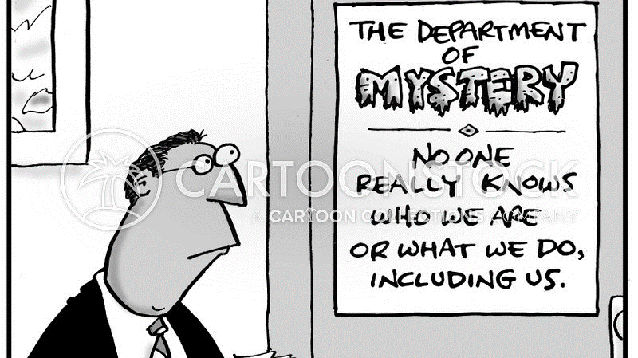

Slide 3
CSA Staff
CSA Account Specialist
Sarah Makomva
Sarah.Makomva@fcva.us
540-722-8394
Purchase Orders, Payments, Invoices, Maintains FAPT Schedule, Maintains Records, Initiates Vendor Contracts
CSA UR/CQI Specialist
Katherine Webster
Katherine.Webster@fcva.us
Utilization Review & Continuous Quality Improvement, CANS SuperUser, Vendor Expert
CSA Coordinator
Jackie Jury, MS, LPC
JJury@fcva.us
540-722-8395
Develop/Manage Policy & Procedures, Compliance, Budget, CANS Local Administrator, FAPT, CPMT, IDT, Data Collection, Training, Contracting

Slide 4

Children’s Services Act History Lesson of the Day
What is the Children’s Services Act?
Pooled funding streams from Virginia Child Serving Agencies: VDSS, VDOE, VDJJ, VDBHDS
The Children’s Services Act was enacted to create a collaborative system of services and funding.
child-centered
family-focused
community-based
Notes:
1993 Legislation through General Assembly

Slide 5
Systems of Care-Family Engagement
Fundamental to CSA is the belief that all families have strengths; families deserve to be treated with dignity and respect; and outcomes improve when families are involved in decision-making
Notes:
Families know their children the best.
Be empathic

Slide 6
Community Policy & Management Team
Mandated through the Code of Virginia
Appointed by the governing board
Local agency heads or their designees from each agency, Private Provider Representative, and Parent Representative
NWCSB- Denise Acker, Current Chair
County Admin- Jay Tibbs
FCPS- Dr. Michele Sandy
DSS- Tamara Green
JCSU- Jerry Stollings
VDH- Leea Shirley
Private Provider Representative- David Alley, Grafton Integrated Health Network
Parent Representative- Vacant
Notes:
Local Governing Board- FC Board of Supervisors

Slide 7
CPMT Responsibilities
Develop local interagency procedures governing the provision of services
Develop policies governing access to CSA Pool Funds, including a parental contribution for services, fiscal procedures, referrals to FAPT, utilization review, ICC, appeals, Emergency Funding, etc.
Authorize and monitor the expenditure of funds by FAPT or MDT
Collect and submit data to the State Executive Council as required
Notes:
More responsibilities

Slide 8
Family Assessment and Planning Team
Mandated through the Code of Virginia
Appointed by the CPMT
Agency representatives who have authority to access services within their respective agencies, Private Provider Representative, and Parent Representative
FCPS- Julia Vettorel
NWCSB- Robin Hockman
DSS- Jen Smith/Paula Orndorff
JCSU- Jen Osbourne
Private Provider Representative- Vacant
Parent Representative- Vacant
Members who serve are immune from liability unless it is proven that they acted with malicious intent

Slide 9
FAPT Responsibilities
Review referrals to the team
Provide for family participation in all aspects of assessment, planning, and implementation of services
Provide for participation of foster parents for permanent foster care or long-term foster care placement; CM shall notify foster parents of meetings, opinions of foster parents shall be considered
Develop an IFSP that provides for appropriate cost-effective services
Identify youth at risk of entering, or placed in, residential treatment who can be effectively served in their communities. The FAPT shall:
Identify the strengths & needs of child & family-through conducting/reviewing comprehensive assessments including the CANS
Identify specific services and supports necessary to meet the identified needs
Implement a plan for returning the youth to the home or community, including identifying services/supports to assist with the transition
Provide Utilization Review of services to determine whether the services/placement continue to provide the most appropriate, least restrictive and effective services

Slide 10
FAPT Responsibilities, cont.
Assess parents/legal guardians to contribute financially to the cost of services being provided, where not specifically prohibited by law
Refer youth and families to community agencies and resources in accordance with the IFSP
Recommend the use of CSA funds to CPMT
Designate a person responsible for monitoring and reporting on the progress being made in fulfilling the IFSP

Slide 11
CSA Eligibility
Mandated
Sum Sufficient vs Non Sum Sufficient
Protected

Slide 12
Mandated Eligibility
Sum Sufficient
IEP Special Education Private Day School and Residential Treatment Facility placements and related services
Foster Care Youth
Foster Care Prevention
Abuse/Neglect
CHINServices
FAPT
Court
Non Sum Sufficient
*Requires Signed IEP
Special Education WrapAround
Non residential services provided in the home or community for a student at risk of more restrictive placement when their needs associated with his/her disability extend beyond the school setting.
Special Education Transition Services
IEP services provided in the public school to assist with transition from private day or residential setting.

Slide 13
Eligibility
Protected
Emotional or Behavioral problems over a persistent length of time or if short length, are of such critical nature that intervention is warranted
and
Significantly present and disabling in several community settings
and
Require services beyond normal agency resources or multi-agency collaboration

Slide 14
COV§16.1.228 CHINS-Services Definition
"Child in need of services" means (i) a child whose behavior, conduct or condition presents or results in a serious threat to the well-being and physical safety of the child or (ii) a child under the age of 14 whose behavior, conduct or condition presents or results in a serious threat to the well-being and physical safety of another person; however, no child who in good faith is under treatment solely by spiritual means through prayer in accordance with the tenets and practices of a recognized church or religious denomination shall for that reason alone be considered to be a child in need of services, nor shall any child who habitually remains away from or habitually deserts or abandons his family as a result of what the court or the local child protective services unit determines to be incidents of physical, emotional or sexual abuse in the home be considered a child in need of services for that reason alone.

Slide 15
CHINS-Services continued
However, to find that a child falls within these provisions, (i) the conduct complained of must present a clear and substantial danger to the child's life or health or to the life or health of another person, (ii) the child or his family is in need of treatment, rehabilitation or services not presently being received, and (iii) the intervention of the court is essential to provide the treatment, rehabilitation or services needed by the child or his family.

Slide 16
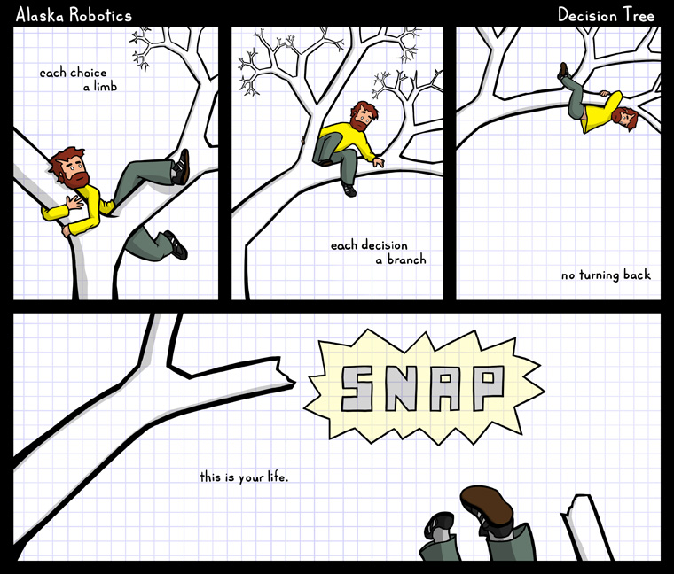
Can CSA Pay?

Slide 17
Decision Tree:
Can CSA Pay

Slide 18
Case Manager Responsibilities
Exhaust all other funding resources including Medicaid, Private Insurance, Services through sliding fee scale or civic organizations (ie-Big Brother/Big Sister)
Complete CSA documentation & inform family of potential Parental Contribution/Copayment
Prepare Family for meeting
Ongoing case management

Slide 19


Sympathy vs Empathy

Slide 20
Other Funding Sources
Providing Safe and Stable Families-PSSF
Virginia Juvenile Community Crime Control Act-VJCCCA
Sinclair Health Clinic
SSI or SSA
Adoption Assistance
Private Insurance
Child Support
Child Care Assistance
Community Partners-spiritual groups, non-profit agencies, etc.

Slide 21
Medicaid
Waivers
Building Independence for Individuals 18 and Older
Commonwealth Coordinated Care Plus (CCC+)- *No wait list. Contact DMAS
Home & Community Care- Living, nursing, respite, assistive technology, environmental modifications
EPSDT-Early Periodic Screening, Diagnostic, and Treatment
Comprehensive and preventive health care services for children under age 21 who are enrolled in Medicaid.
“Correct or ameliorate defects and physical and mental illnesses or conditions”
ABA
Developmental Disabilities- *Waiting list based on urgency of need. Apply through CSB
Family & Individual Support
CL-Community Living

Slide 22
Medicaid, Cont.
Cardinal Care
Full continuum
Service Exclusions:
Service duplications
Community based services through Acute Psychiatric Hospitalization
Undefined services (Parent Mentoring, Respite, Early Intervention Services, Mentoring, etc.)
FAMIS does not cover PRTF
MCO Added Benefits
Medallion 4.0 Health Plan Added Benefit Chart
Formerly Fee for Service, CCC+, and Medallion 4.0
6 MCOs- Aetna Better Health, Anthem Healthkeepers Plus, Molina Healthcare, Optima Healthcare, United Healthcare, Virginia Premier Health
Notes:
Jan 1, 2023 CCC+, Medallion 4.0 & FFS merged to Cardinal Care
served by 6 MCOs
Added Benefits- Link…

Slide 23
Before FAPT
Discuss Strengths & Needs
CANS
Identify the youth and family’s strength & needs
Schedule FAPT Meeting
FAPT
Complete & Submit CSA Initial Documentation
DOCS
Initial Referral Form
Parent/Guardian/Youth Signatures
Discuss the services with the family
Expectations for youth and family participation
Is the family willing to actively participate in service?
CANS
Budget Request Form
Provide any recent Evaluations/Assessments or Vendor Reports
Signed Foster Care Prevention Eligibility Determination (if applicable)
Deadline for submission is midnight, Tuesday prior to meeting unless otherwise notified
Consent to Release and Exchange Information
Releases must include CSA, FAPT, & CPMT
Youth 14 and over must sign the ROI
Submit & Contact Robbin Lloyd to schedule 540-722-8394 or Robbin.Lloyd@fcva.us
Will requested services best meet the needs of the family?
Rights & Safeguards/Appeals form- sign & return Acknowledgement Page
How much time can/will they realistically engage in the service? How much time can they devote?

Slide 24
Before FAPT, cont.
Notify & Invite all involved parties to the meeting.
Include Youth, Family (Biological & Foster), Service Provider
Follow Up to ensure invited parties will be present.
INVITE
Talk to youth and family about what to expect during a FAPT meeting: Who’s at the table,
What will be discussed, Etc.
Inform the family that they will be assessed a financial contribution for services or referred to DCSE for collection of child support.
PREP
If you already have a vendor in mind, contact them:
Do they have appropriate service?
Do they have a worker that fits well with the family?
Do they have availability?
CONTACT

Slide 25
FAPT IS…
Clinical
Regulated
Governed by rules and regulations of the Commonwealth of VA and local CPMT policy, and some federal regulations as well
A Clinical team that reviews the services being requested and what is being provided, and makes recommendations of appropriate services to the CPMT, which may or may not be the same services as being requested
Responsible to ensure services provided are: least restrictive, clinically appropriate and fiscally responsible

Slide 26
FAPT is NOT…
A funding body
A rubber stamp
A hoop to jump through
Red tape

Slide 27
What to Expect at FAPT
Welcome & Introductions
Case Manager-
Brief history of client/family-include reason for referral to FAPT
Past and/or current services-what worked/what didn’t
Client & family strengths
Family & Youth provide information
Discussion/Questions
FAPT recommendations/Budget Sheet reviewed, Participation & Consent signed
Next FAPT meeting scheduled

Slide 28
What does FAPT Expect?
Do not “take a pass” and ask the provider to give the update.
FAPT needs to understand WHY a service is necessary.
Be detailed and descriptive about behavior and progress.
Talk about goals- what are the expectations.
Don’t say someone was aggressive. That could mean anything.
When discussing services, talk about continued needs and barriers.
ALWAYS talk to providers about discharge timelines. CSA funds are time LIMITED.
**You should be telling the provider what the goals are, NOT the other way around!**

Slide 29
Typical Questions Asked in FAPT
What are the prior services, resources, interventions tried to alleviate the problem?
Have other funding sources been ruled out?
How long have the problem behaviors lasted? Frequency, duration, intensity, and across what settings?
What are the barriers to less restrictive services?
What are the identified goals for the indicated service?
What are the step-down plans?

Slide 30
After FAPT… Intermediary Funding Team
Intermediary Funding Team (IFT)
Funding Reviewed/Temporarily Authorized by IFT
Meets weekly on Thursdays- except on holidays
CMs notified of denials or contingencies
POSO created for authorized services (except for certain one time payments)
If any information is listed as unknown or TBD on the budget sheet, no POSO for that service is created. CM MUST notify CSA Account Specialist of provider and rate to issue POSO prior to services being initiated.
CM can notify vendor that once they receive, sign, and return the POSO, services may begin

Slide 31
Ongoing Case Management responsibilities
Coordinate and Monitor Services
Make sure services start in a timely manner
Discuss FAPT identified goals and needs with provider, and alignment of provider activities and interventions with those goals
SMART goals
Specific, Measurable, Achievable, Relevant, Time limited
Monitor for youth and family participation and full utilization of service hours
Make sure the provider is a “good fit” without frequent staff changes
Participate in treatment team meetings

Slide 32
Ongoing Case Management, Cont.
Reviews
CANS
FAPT Follow Up form
Budget Request form (if needed)
Vendor Progress Notes
Notification of changes
Service changes
Termination
Provider Changes
Address change/Relocation
Family obtains/loses insurance-Medicaid, Private Insurance, etc

Slide 33
CANS- Child and Adolescent Needs and Strengths
Mandatory Uniform Assessment Required
Guides service planning
Assesses service outcomes
Establishes a baseline and gauges progress
Required for all children and adolescents who receive CSA funded services

Slide 34
CANS Cont.
What do different scores mean?
Closing out the CANS-with 60 days
CANS Certification
https://www.schoox.com/login.php
CANVaS 2.0 Request to Create Account
Submit both to CSA Coordinator to create CANVaS 2.0 Account
CANVaS 2.0
https://www.csa.canvas.virginia.gov/
Complete based on Approved Schedule
Notes:
Send me certificate to update CANVaS account.

Slide 35
Review Frequency
Service FAPT/MDT Review CANS Completion
Congregate Care | Every 3 months | Comprehensive-Initial & Discharge Reassessment-Annually/Every 3 months
Community Based Services, Foster Care Prevention | Every 3 months | Comprehensive-Initial & Discharge Reassessment-Annually/Every 3 months
Treatment Foster Care Only | Every 6 months | Comprehensive-Initial & Discharge Reassessment-Annually/Every 6 months
Basic & Enhanced Maintenance or Fostering Futures, and Clothing Only | Annually | Comprehensive-Initial & Discharge Reassessment-Annually
Private Day School Only | Every 6 months, or Annually with justification to FAPT | Comprehensive-Initial & Discharge Reassessment-Annually/Every 6 months
Change in Level of Care | Prior to change in placement or within 14 days of Emergency Funding

Slide 36
Helpful Links
CSA Web Portal
Click “Sign up for Case Managers Portal” and complete form for access
Most Up-to-date forms
Frederick County Policy & Procedure Manual
Current Contracted Vendors & Rates
IFT & CPMT dates
Local Training, Resources, FAQ’s
Office of Children's Services
CANS Information
State CSA Policy Manual and User Guide
Training Material
VA Learning Center

Slide 37


Slide 38
Contact Us
Jackie Jury
CSA Coordinator
Frederick County, VA
540-722-8395
JJury@fcva.us
Katherine Webster
CSA UR/CQI Specialist
Frederick County, VA
540-546-8032
Katherine.Webster@fcva.us
Sarah Makomva
CSA Account Specialist
Frederick County, VA
540-722-8394
Sarah.Makomva@fcva.us

