Slide 1

Let’s Get Up And Move Around!

Slide 2


This is a fun and easy fitness activity that gets the whole family involved.
This Photo by Unknown Author is licensed under CC BY-NC-ND

Slide 3


It’s called “Fitness Spots”

Slide 4

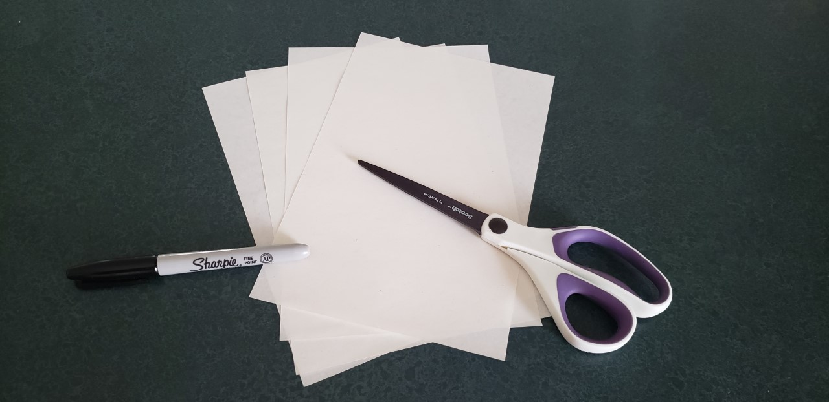
First, find your materials.

Slide 5
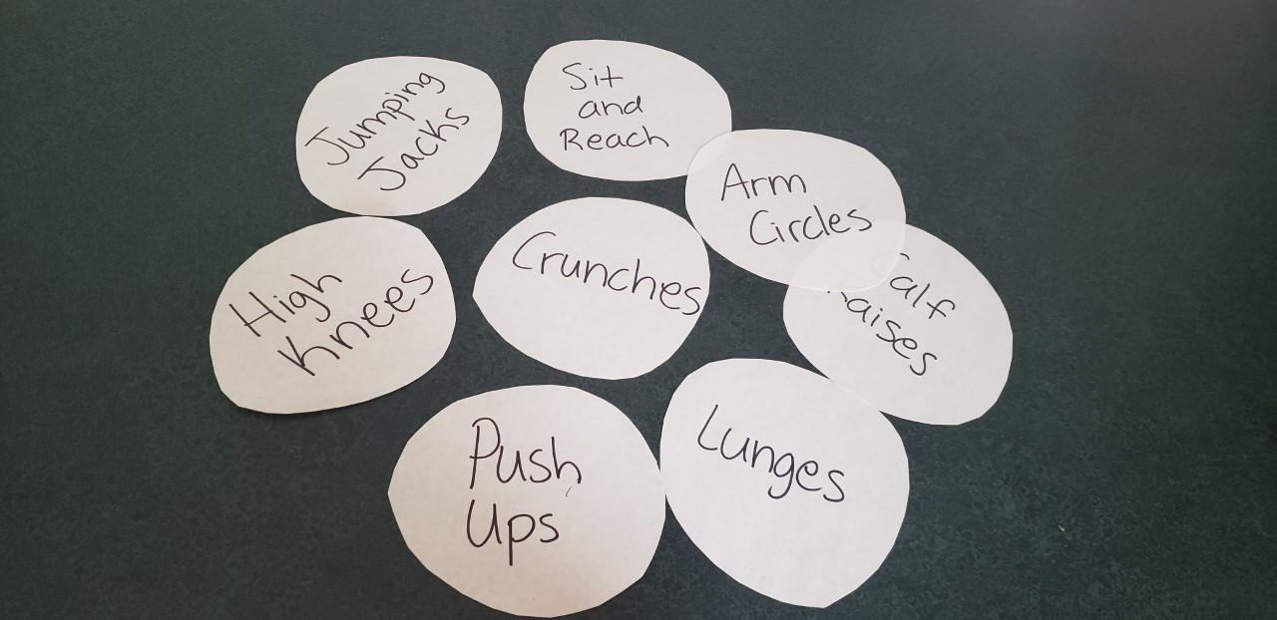
Cut circles out of the paper and write a different exercise on each circle.

Slide 6
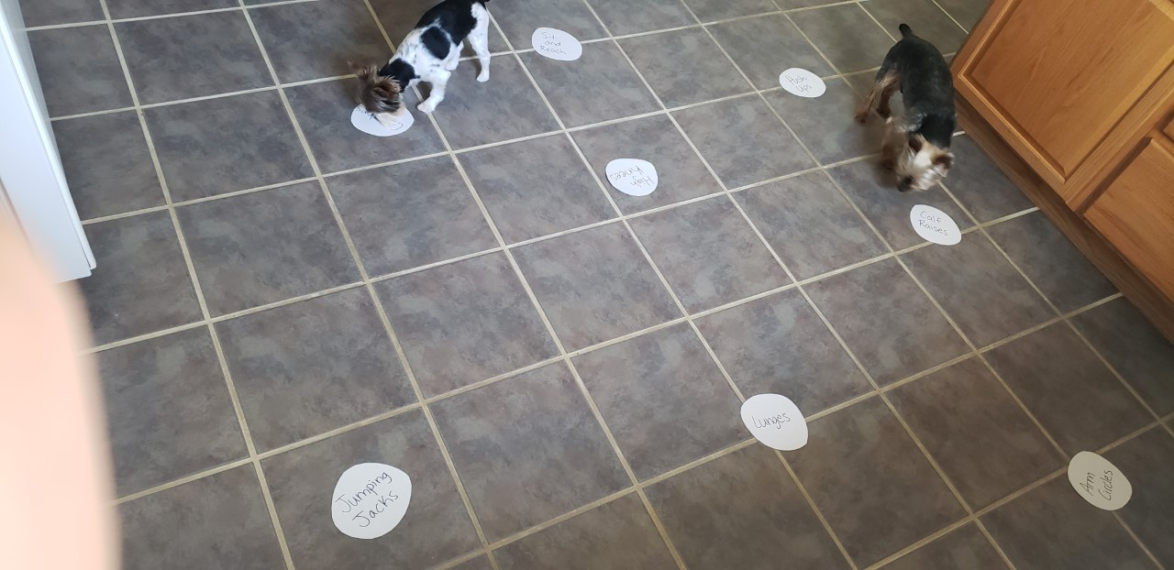
Now, set out all your spots in a room or even outside. (Dogs can join.)

Slide 7

Then, put on some music.
This Photo by Unknown Author is licensed under CC BY-NC

Slide 8
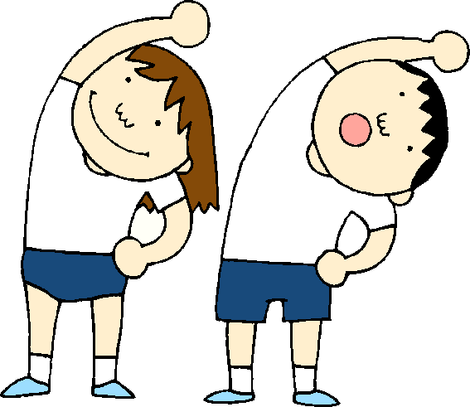
Go around to each spot and do each exercise for about 15 seconds and then go to the next one.
This Photo by Unknown Author is licensed under CC BY-NC-ND
This Photo by Unknown Author is licensed under CC BY-SA
This Photo by Unknown Author is licensed under CC BY-SA

Slide 9
Hope you enjoyed this fun family activity and don’t forget to stretch!

