Slide 1

FAPT Training
October 24, 2017

Slide 2

History Lesson for the Day
The Children’s Services Act was enacted to create a collaborative system of services and funding.
  child-centered
  family-focused
  community-based
Pooled funding streams from Virginia Child Serving Agencies: VDSS, VDOE, VDJJ, VDBHDS
Notes:
1993 Legislation through General Assembly

Slide 3
Statutory Requirements for FAPT
§ 2.2-5207. Family assessment and planning team; membership; immunity from liability
  Membership shall include representatives who have authority to access services within their respective agencies: CSB, JCSU, DSS, FCPS & Parent Rep, Private Provider Rep, & DoH if determined by CPMT
  Members who serve are immune from liability unless it is proven that they acted with malicious intent

Slide 4
§ 2.2-5208. Family assessment and planning team powers and duties
  Review referrals to the team
  Provide for family participation in all aspects of assessment, planning, and implementation of services
  Provide for participation of foster parents for permanent foster care or long-term foster care placement; CM shall notify foster parents of meetings, opinions of foster parents shall be considered
  Develop an IFSP that provides for appropriate cost-effective services
  Identify youth at risk of entering, or placed in, residential treatment who can be effectively served in their communities. The FAPT shall:
    Identify the strengths & needs of child & family-through conducting/reviewing comprehensive assessments including the CANS
    Identify specific services and supports necessary to meet the identified needs
    Implement a plan for returning the youth to the home or community, including identifying services/supports to assist with the transition
    Provide Utilization Review of services to determine whether the services/placement continue to provide the most appropriate, least restrictive and effective services

Slide 5
  Assess parents/legal guardians to contribute financially to the cost of services being provided, where not specifically prohibited by law
  Refer youth and families to community agencies and resources in accordance with the IFSP
  Recommend the use of CSA funds to CPMT
  Designate a person responsible for monitoring and reporting on the progress being made in fulfilling the IFSP

Slide 6
Eligibility
Mandated
  IEP Special Education Private Day School and Residential Treatment Facility placements and related services
  Special Education WrapAround
  Foster Care Youth
  Foster Care Prevention
    Abuse/Neglect
    CHINServices
      FAPT
      Court
NonMandated (Must meet all 3)
  Emotional or Behavioral problems over a persistent length of time or if short length, are of such critical nature that intervention is warranted
  Significantly present and disabling in several community settings
  Require services beyond normal agency resources or multi-agency collaboration

Slide 7
COV§16.1.228 CHINS-Services Definition
"Child in need of services" means (i) a child whose behavior, conduct or condition presents or results in a serious threat to the well-being and physical safety of the child or (ii) a child under the age of 14 whose behavior, conduct or condition presents or results in a serious threat to the well-being and physical safety of another person; however, no child who in good faith is under treatment solely by spiritual means through prayer in accordance with the tenets and practices of a recognized church or religious denomination shall for that reason alone be considered to be a child in need of services, nor shall any child who habitually remains away from or habitually deserts or abandons his family as a result of what the court or the local child protective services unit determines to be incidents of physical, emotional or sexual abuse in the home be considered a child in need of services for that reason alone.

Slide 8
CHINS-Services, con’t.
However, to find that a child falls within these provisions, (i) the conduct complained of must present a clear and substantial danger to the child's life or health or to the life or health of another person, (ii) the child or his family is in need of treatment, rehabilitation or services not presently being received, and (iii) the intervention of the court is essential to provide the treatment, rehabilitation or services needed by the child or his family.

Slide 9
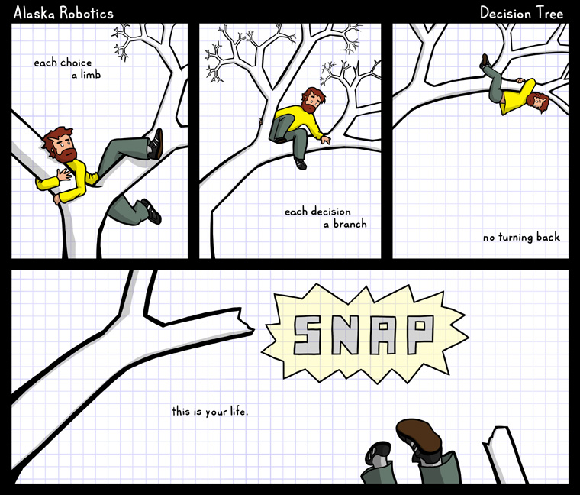
Can CSA Pay?

Slide 11
Other Funding Sources
Providing Safe and Stable Families-PSSF
Virginia Juvenile Community Crime Control Act-VJCCCA
SSI or SSA
Adoption Assistance
Private Insurance
Child Support
Child Care Assistance
Community Partners-spiritual groups, non-profit agencies, etc.

Slide 12
Medicaid
Waivers
  EDCD-Elderly or Disabled with Consumer Direction
    Respite, Attendant Care
  CL-Community Living, formerly ID-Intellectual Disability
    Congregate Care living
  FIS-Family and Individual Supports, formerly DD-Developmental Disabilities
    Community based supports
EPSDT-Early Periodic Screening, Diagnostic, and Treatment
  Comprehensive and preventive health care services for children under age 21 who are enrolled in Medicaid.
    “Correct or ameliorate defects and physical and mental illnesses or conditions”
    ABA

Slide 13
Medicaid Con’t.
Fee for Service/MCO
  Full continuum
    Community based services through Acute Psychiatric Hospitalization
Exclusions:
  Service duplications
  Undefined services (Parent Mentoring, Respite, Early Intervention Services, Mentoring, etc.)
CMs role: varies

