Slide 1

Case Manager Training
March 14, 2018

Slide 2

History Lesson for the Day
The Children’s Services Act was enacted to create a collaborative system of services and funding.
  child-centered
  family-focused
  community-based
Pooled funding streams from Virginia Child Serving Agencies: VDSS, VDOE, VDJJ, VDBHDS
Notes:
1993 Legislation through General Assembly

Slide 3
Systems of Care-Family Engagement
Fundamental to CSA is the belief that all families have strengths; families deserve to be treated with dignity and respect; and outcomes improve when families are involved in decision-making

Slide 4
Community Policy & Management Team
Mandated through the Code of Virginia
  Appointed by the governing board
  Local agency heads or their designees from each agency, Private Provider Representative, and Parent Representative
    FCPS- Michele Sandy- Current Chair
    CA- Jay Tibbs
    NWCSB- Mark Gleason
    DSS- Tami Green
    JCSU- Peter Roussos
    DoH- Colin Greene, MD, MPH
    Private Provider Representative- Dana Bowman, CSV Inc.
    Parent Representative- Dawn Robbins

Slide 5
CPMT Responsibilities
Develop local interagency procedures governing the provision of services
Develop policies governing access to CSA Pool Funds, including a parental contribution for services, fiscal procedures, referrals to FAPT, utilization review, ICC, appeals, etc
Authorize and monitor the expenditure of funds by FAPT or MDT
Collect and submit data to the State Executive Council as required

Slide 6
Family Assessment and Planning Team
Mandated through the Code of Virginia
  Appointed by the CPMT
  Agency representatives who have authority to access services within their respective agencies, Private Provider Representative, and Parent Representative
    FCPS- Melissa Hartman
    NWCSB- Robin Hockman
    DSS- Kim Busch
    JCSU- Mark Legrys
    Private Provider Representative- Jeff Phillips, Family Insight
    Parent Representative- Vacant
  Members who serve are immune from liability unless it is proven that they acted with malicious intent

Slide 7
FAPT Responsibilities
  Review referrals to the team
  Provide for family participation in all aspects of assessment, planning, and implementation of services
  Provide for participation of foster parents for permanent foster care or long-term foster care placement; CM shall notify foster parents of meetings, opinions of foster parents shall be considered
  Develop an IFSP that provides for appropriate cost-effective services
  Identify youth at risk of entering, or placed in, residential treatment who can be effectively served in their communities. The FAPT shall:
    Identify the strengths & needs of child & family-through conducting/reviewing comprehensive assessments including the CANS
    Identify specific services and supports necessary to meet the identified needs
    Implement a plan for returning the youth to the home or community, including identifying services/supports to assist with the transition
    Provide Utilization Review of services to determine whether the services/placement continue to provide the most appropriate, least restrictive and effective services

Slide 8
FAPT Responsibilities continued
  Assess parents/legal guardians to contribute financially to the cost of services being provided, where not specifically prohibited by law
  Refer youth and families to community agencies and resources in accordance with the IFSP
  Recommend the use of CSA funds to CPMT
  Designate a person responsible for monitoring and reporting on the progress being made in fulfilling the IFSP

Slide 9
Eligibility
Mandated
  IEP Special Education Private Day School and Residential Treatment Facility placements and related services
  Special Education WrapAround
  Foster Care Youth
  Foster Care Prevention
    Abuse/Neglect
    CHINServices
      FAPT
      Court
NonMandated (Must meet all 3)
  Emotional or Behavioral problems over a persistent length of time or if short length, are of such critical nature that intervention is warranted
  Significantly present and disabling in several community settings
  Require services beyond normal agency resources or multi-agency collaboration

Slide 10
COV§16.1.228 CHINS-Services Definition
"Child in need of services" means (i) a child whose behavior, conduct or condition presents or results in a serious threat to the well-being and physical safety of the child or (ii) a child under the age of 14 whose behavior, conduct or condition presents or results in a serious threat to the well-being and physical safety of another person; however, no child who in good faith is under treatment solely by spiritual means through prayer in accordance with the tenets and practices of a recognized church or religious denomination shall for that reason alone be considered to be a child in need of services, nor shall any child who habitually remains away from or habitually deserts or abandons his family as a result of what the court or the local child protective services unit determines to be incidents of physical, emotional or sexual abuse in the home be considered a child in need of services for that reason alone.

Slide 11
CHINS-Services continued
However, to find that a child falls within these provisions, (i) the conduct complained of must present a clear and substantial danger to the child's life or health or to the life or health of another person, (ii) the child or his family is in need of treatment, rehabilitation or services not presently being received, and (iii) the intervention of the court is essential to provide the treatment, rehabilitation or services needed by the child or his family.

Slide 12
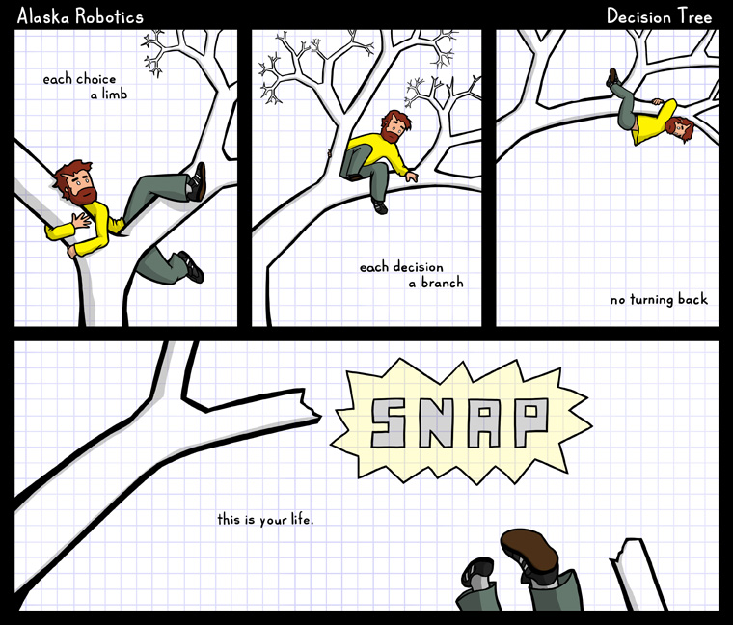
Can CSA Pay?

Slide 13
Decision Tree:
Can CSA Pay

Slide 14
Case Manager Responsibilities
Exhaust all other funding resources including: Medicaid, Private Insurance, Services through sliding fee scale or civic organizations (ie-Big Brother/Big Sister)
1
Complete CSA documentation & inform family of potential Parental Contribution/Copayment
2
Prepare Family for meeting
3
Ongoing case management
4

Slide 15
Other Funding Sources
Providing Safe and Stable Families-PSSF
Virginia Juvenile Community Crime Control Act-VJCCCA
Sinclair Health Clinic
SSI or SSA
Adoption Assistance
Private Insurance
Child Support
Child Care Assistance
Community Partners-spiritual groups, non-profit agencies, etc.

Slide 16
Medicaid
Waivers
EDCD-Elderly or Disabled with Consumer Direction
Respite, Attendant Care
CL-Community Living, formerly ID-Intellectual Disability
Congregate Care living
FIS-Family and Individual Supports, formerly DD-Developmental Disabilities
Community based supports
EPSDT-Early Periodic Screening, Diagnostic, and Treatment
Comprehensive and preventive health care services for children under age 21 who are enrolled in Medicaid.
“Correct or ameliorate defects and physical and mental illnesses or conditions”
ABA

Slide 17
Medicaid Continued
Fee for Service/MCO/FAMIS Plus
Full continuum
Exclusions:
Service duplications
Community based services through Acute Psychiatric Hospitalization
Undefined services (Parent Mentoring, Respite, Early Intervention Services, Mentoring, etc.)
FAMIS does not cover PRTF

Slide 18
Before FAPT
Discuss Strengths & Needs
Identify the youth and family’s strength & needs
Schedule FAPT Meeting
Complete & Submit CSA Initial Documentation
Initial Referral Form
Parent/Guardian/Youth Signatures
Discuss the services with the family
Expectations for youth and family participation
Is the family willing to actively participate in service
CANS
Budget Request Form
Provide any recent Evaluations/Assessments or Vendor Reports
Signed Foster Care Prevention Eligibility Determination (if applicable)
Deadline for submission is midnight, Wednesday prior to meeting unless otherwise notified
Consent to Release and Exchange Information
Releases must include CSA, FAPT, & CPMT
Youth 14 and over must sign the ROI if any SA issues are suspected
Rights & Safeguards/Appeals form
Submit & Contact Annie Kennedy to schedule 540-722-8394 or annie.kennedy@fcva.us
Will they best meet the needs of the family?

Slide 19
Before FAPT, continued…
Invitations
Prepare Family
Contact the Vendor
If you already have a vendor in mind, contact them:
Talk to youth and family about what to expect during a FAPT meeting
Do they have appropriate service?
Do they have a worker that fits well with the family?
Do they have availability?
Who’s at the table
What will be discussed
Inform the family that they will be assessed a financial contribution for services or referred to DCSE for collection of child support
Include Youth, Family, Provider (if any)
Follow Up to ensure invited parties will be present
Notify & Invite involved parties to the meeting

Slide 20
Before FAPT, continued…
FAPT is…
FAPT is…
Governed by rules and regulations of the Commonwealth of VA and local CPMT policy, and some federal regulations as well
A Clinical team that reviews the services being requested and what is being provided, and makes recommendations of appropriate services to the CPMT, which may or may not be the same services as being requested
Responsible to ensure services provided are: least restrictive, clinically appropriate and fiscally responsible

Slide 21
What to Expect at FAPT
Welcome & Introductions
Case Manager
Brief history of client/family-include reason for referral to FAPT
Past and/or current services-what worked/what didn’t
Client & family strengths
Family & Youth provide information
Discussion/Questions
FAPT recommendations/Budget Sheet reviewed, Participation & Consent signed
Next FAPT meeting scheduled

Slide 22
Typical Questions Asked in FAPT
What are the prior services, resources, interventions tried to alleviate the problem?
Have other funding sources been ruled out?
How long have the problem behaviors lasted, and across what settings?
What are the barriers to less restrictive services?
What are the identified goals for the indicated service?
What are the step-down plans?

Slide 23
After FAPT
Funding Reviewed/Authorized by CPMT
  4th Monday except on holidays
  CMs notified of denials or contingencies
POSO created for authorized services (except for one time payments)
  If any information is listed as unknown or TBD on the budget sheet, no POSO for that service is created until CSA Account Specialist is provided with that information
CM can notify vendor that once POSO is signed and returned, services can begin

Slide 24
Ongoing Case Management responsibilities
Coordinate and Monitor Services
  Make sure services start in a timely manner
  Be a part of goal setting with provider and family
    SMART goals
      Specific, Measurable, Achievable, Relevant, Time bound
  Monitor for youth and family participation and full utilization of service hours
  Make sure the provider is a “good fit” without frequent staff changes
  Participate in treatment team meetings

Slide 25
Ongoing Case Management Continued
Reviews
  CANS
  FAPT Follow Up form
  Budget Request form (if needed)
  Vendor Progress Notes
Notification of changes
  Service changes
    Termination
    Provider Changes
  Address change/Relocation
  Family obtains/loses insurance-Medicaid, GAP, Private, etc

Slide 26
CANS- Child and Adolescent Needs and Strengths
Mandatory Uniform Assessment Required
Guides service planning
Assesses service outcomes
Establishes a baseline and gauges progress
Required for all children and adolescents who receive CSA funded services

Slide 27
CANS Continued
What different scores mean?
Closing out the CANS-with 60 days
Certification required
  tcomtraining.com
  Annual recertification
CANVaS 2.0 UserAgreement Required
  csa.canvas.virginia.gov
Complete based on Approved Schedule

Slide 28
Review Frequency
Service FAPT/MDT Review CANS Completion
Congregate Care (IEP Exception), Adoption Assistance placements | Every 3 months | Comprehensive-Initial & Annually Reassessment-Every 3 months Discharge
Community Based Services, Foster Care Prevention | Every 3 months | Comprehensive-Initial & Annually Reassessment-Every 3 months Discharge
Treatment Foster Care Only | Every 6 months | Comprehensive-Initial & Annually Reassessment-Every 6 months Discharge
Basic Maintenance & Clothing Only | Annually | Comprehensive-Initial & Annually Discharge
IEP Placements | Every 6 months, or Annually with justification to FAPT | Comprehensive-Initial & Annually Reassessment-Every 3 months, or 6 months for Private Day School Discharge
Step Down/New Placement (except Emergency Funding) | Prior to change in placement | Upon change of placement

Slide 29
Forms

Slide 30
Questions????

Slide 31
Contact Us
Jackie Jury
CSA Coordinator
Frederick County, VA
540-722-8395
jjury@fcva.us
Brittany Brewer
CSA Account Specialist
Frederick County, VA
540-722-8394
barnold@fcva.us

