Slide 1

CANS
Refresher
July 24, 2019

Slide 2
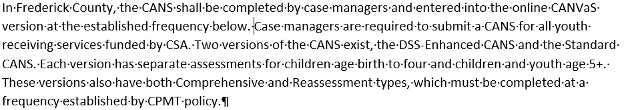
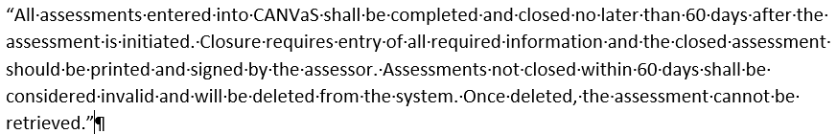
Policy

Slide 3
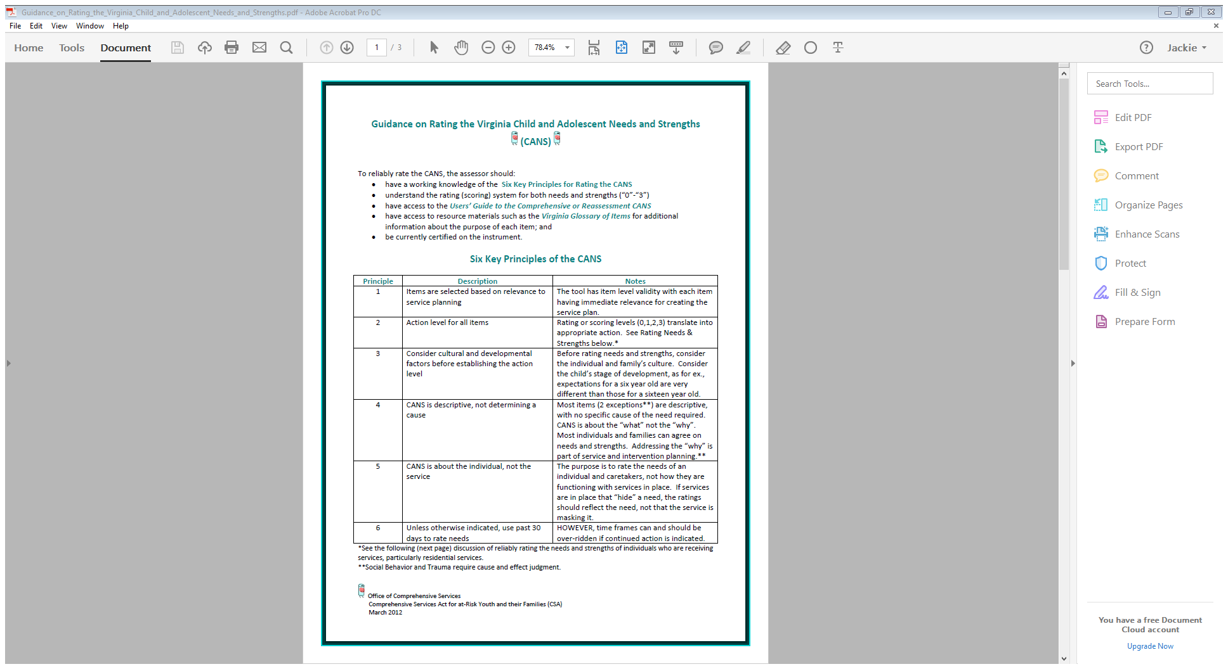
Six Key Principles of the CANS

Slide 4
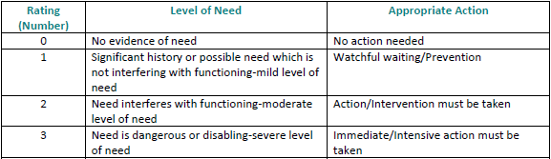
Rating Needs Items

Slide 5
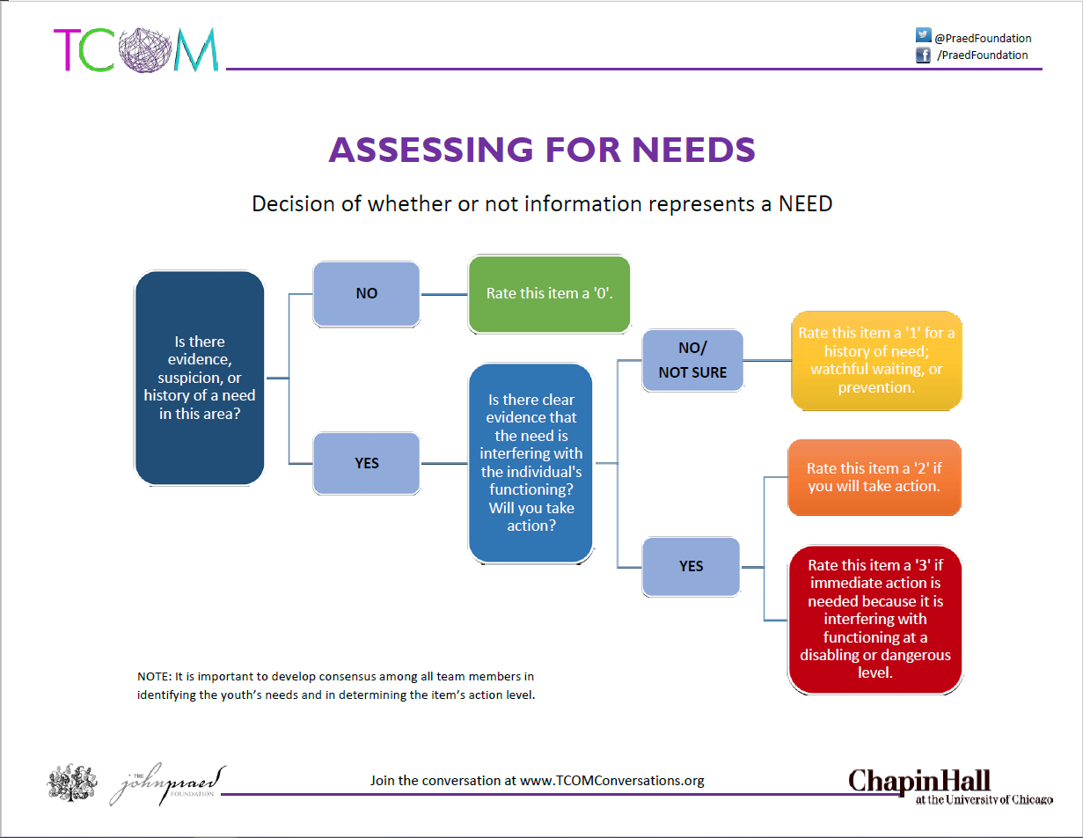

Slide 6
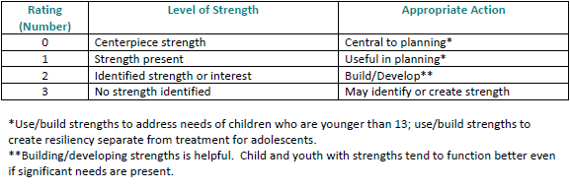
Rating Strength Items

Slide 7
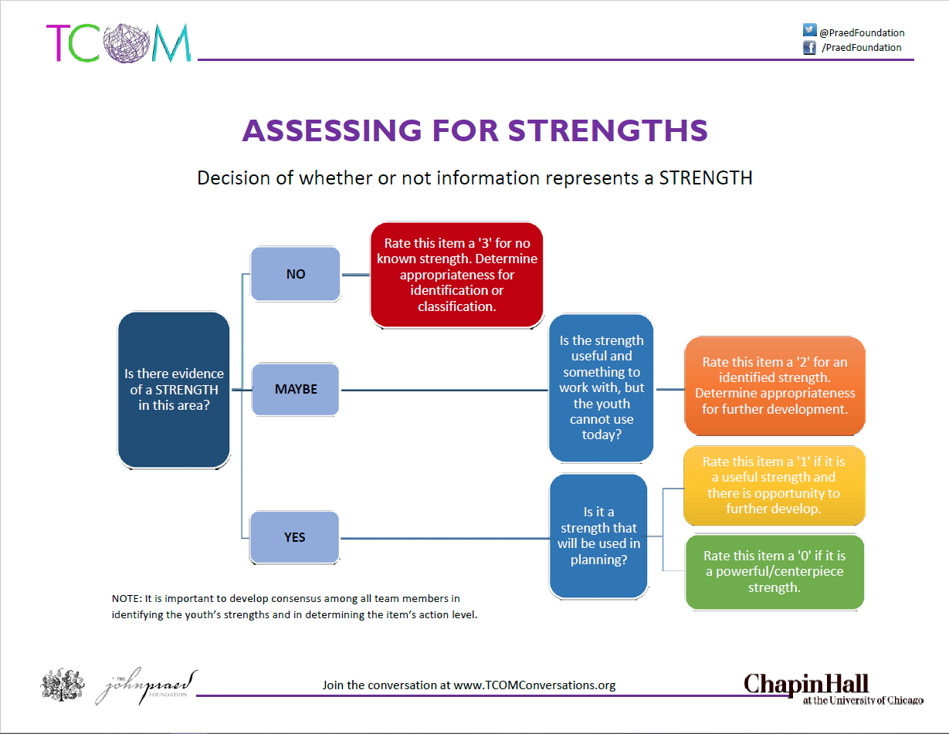

Slide 8
Caregiver Ratings
The intent of the Caregiver Assessment is to evaluate the progress or lack of progress of the previous or potential caregivers in resolving issues which prevent the child from placement (e.g., returning home) and to document why the child can or cannot be placed with that caregiver.
Accurately rating the caregiver assists in making service decisions. For example, if the parent rates “2”s and “3”s on critical items such as “Knowledge of the child’s needs” or “Residential Stability” return home may not yet be appropriate. Or, if the parent/caregiver is rating “0”s or “1”s on many items, the assessment provides documentation that indicates the parents may be ready for return home. Lastly, if the repeatedly indicate lack of progress, or regression (see the “Permanency Report” information in the next section), the agency has documentation which supports the decision to place the child with a relative or move to TPR/Adoption.

Slide 9
Caregiver Ratings, con’t
When children are removed from their families by LDSS, the initial goal is reunification. Therefore, the child’s parent(s) should always be rated on the caregiver assessment. Anyone who is a potential caregiver for the child may be rated. The ability to rate multiple caregivers supports the DSS effort to concurrently plan for permanency for children by rating not only the parents, but relatives, fictive kin, and or prospective foster/adoptive families.

Slide 10
Caregiver Ratings, con’t
***IMPORTANT *** Rate each past or potential caregiver separately as if the item only applies to that person. Some of the questions are historical; others refer to the last thirty days. Often the next question is - “How can I rate the last 30 days for the caregiver if the child has been in foster care?” Or “How can I rate this caregiver if the child has never lived with them?”
The caregiver assessment is about the caregiver’s situation, not the child’s and about how this individual could care for this child. Rate this caregiver as if you were planning to place the child with that person within the next 30 days. Assess the caregiver’s current strengths and needs. For example, what is the condition of the caregiver’s home? Is the caregiver working well with you as the case manager to make it possible for the child to be placed with him or her? Is the caregiver visiting the child?

Slide 11
Reliability
Have a working knowledge of the Six Key Principles for Rating the CANS
Understand the Rating (Scoring) system for both needs and strengths (0-3)
Have access to the Users’ Guide to the Comprehensive or Reassessment CANS
Have access to the resource materials such as the Item and Rating Definitions Manuals for additional information about the purpose of each item; and
Be currently certified on the instrument

Slide 12
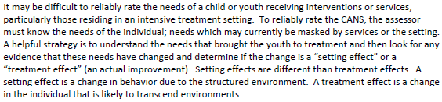
Reliably Rating Clients in Residential Settings

Slide 13
CANS Administration Frequency
CANS Comprehensive:
Initial Referral, Annually, and Case Closure
For Foster Care Maintenance only (Basic Maintenance and Clothing Allowance) cases, a CANS is only due annually and therefore a DSS-Enhanced CANS Comprehensive is always completed.
CANS Reassessment:
Congregate Care settings-every 3 months
Private Day School placements-every 6 months
Treatment Foster Care Only-every 6 months
Community Based Services-every 3 months

Slide 14
FAPT/CANS Administration Frequency
Service | FAPT/MDT Review | CANS Completion
Congregate Care (IEP Exception), Adoption Assistance placements** | Every 3 months | Comprehensive-Initial & Annually Reassessment-Every 3 months Discharge
Community Based Services, Foster Care Prevention | Every 3 months | Comprehensive-Initial & Annually Reassessment-Every 3 months Discharge
Treatment Foster Care Only | Every 6 months | Comprehensive-Initial & Annually Reassessment-Every 6 months Discharge
Basic Maintenance & Clothing Only | Annually | Comprehensive-Initial & Annually Discharge
Placements made through an IEP | Every 6 months, or Annually with justification to FAPT | Comprehensive-Initial & Annually Reassessment-Every 3 months, or 6 months for Private Day School Discharge
Step Down/New Placement (except Emergency Funding) | Prior to change in placement | Upon change of placement

Slide 15
Resources
OCS CANS Information
http://www.csa.virginia.gov/Cans/Index
CANS Training Site
https://www.schoox.com/login.php
CANVaS 2.0 Website
https://www.csa.canvas.virginia.gov

