Slide 1
HIPAA Training
Frederick County Fire and Rescue Department

Slide 2

What is HIPAA??
HIPAA = Health Insurance Portability and Accountability Act. Federal Law that was passed in 1996.
Created by – United States Department of Health and Human Services (DHHS).

Slide 3

Still not clear??
HIPAA is a common set of standards that protects certain Protected Health Information (PHI).
There are several components – but, we are most concerned with the “Privacy Rule.”

Slide 4

The Privacy Rule
The intent of the Privacy Rule is to provide basic rights regarding the use of “Protected Health Information” (PHI).
It protects all “individually identifiable health information.”
Electronic, paper, or oral.
Applies to “covered entities.”

Slide 5
Who is a Covered Entity?
Three Categories:
Health plans.
Health care clearing houses.
Health care providers who transmit any health information electronically.
FCFRD falls under the
Health Care Provider category!
Law Enforcement is NOT a covered entity, and therefore is not entitled to PHI.

Slide 6
Who is a Covered Entity?
A Healthcare Provider | A Health Plan | A Healthcare Clearinghouse
Doctors Clinics Nursing Homes Urgent Care Facilities Jail Medical Staff Someone of equal or higher medical certification/license involved with the treatment from the origin of transport and continuity of care at the destination hospital | Health Insurance Companies HMOs Company Health Plans Government Programs for healthcare | A billing service A repricing company (which takes the bills, matches them up with the insured’s contract with the hospital, and adjusts them to the pre-negotiated price). A community health management information system or community health information system

Slide 7

What’s Required?
The Privacy Rule requires Covered Entities to:
Protect PHI.
Designate a Privacy Officer.
Look for “leaks” in the policy.
Conduct/document training for the ENTIRE Department.
Develop an Authorization Form for release of PHI.

Slide 8
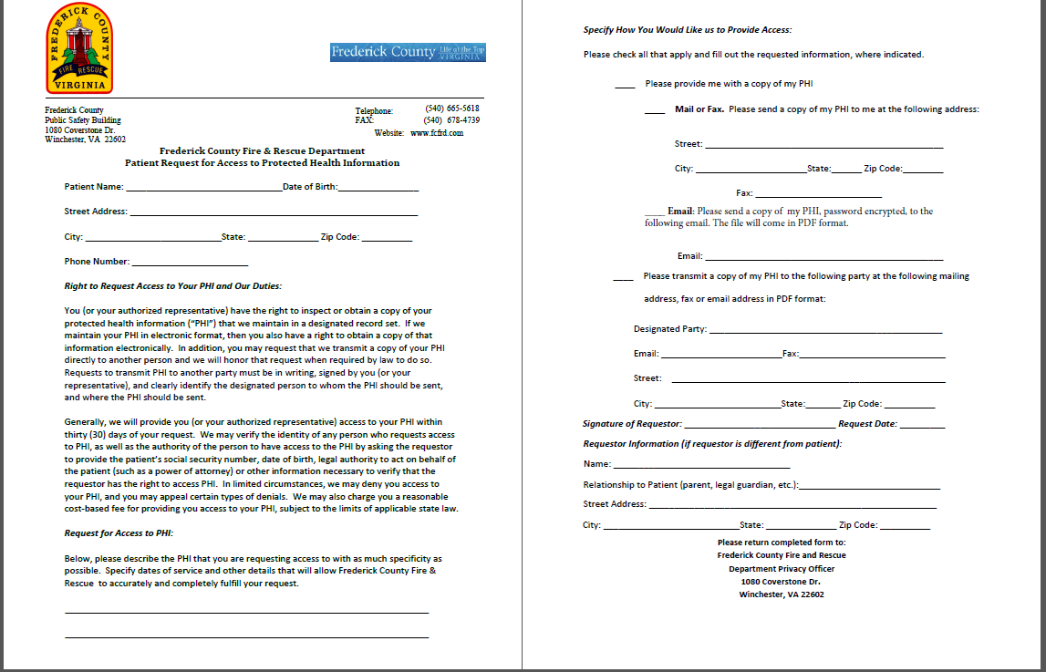
FCFRD PHI Request form found on our website at www.fcfrd.com

Slide 9
More Requirements
Develop a Notice of Privacy Practices
When permitted, always disclose only the minimum necessary Protected Health Information (PHI)
Update policies and procedures
Identify Business Associates and create contracts
Apply reasonable administrative, technical, and physical safeguards

Slide 10

Privacy Officer
An individual within the organization that is responsible for developing and implementing policies and procedures required by HIPAA.
Frederick County Fire and Rescue Department’s Privacy Officer is EMS Billing Manager Christine Bauserman.

Slide 11

Protected Health Information
PHI is any information created or received by a health care provider which relates to:
Past, present, or future physical or mental conditions.
Provision of health care.
Past, present, or future payment for care.

Slide 12

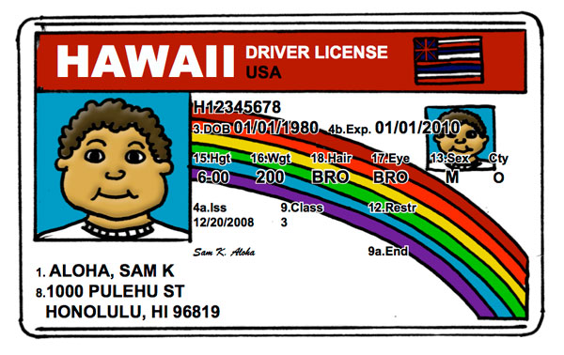
Examples of PHI
Name
Address
Date of Birth / Age
Social Security Number
Scene pictures that include license plates
Medical condition / past medical history
Full face photos

Slide 13

HIPAA should NEVER negatively impact the quality of patient care or impede the ability to provide care!!
The appropriate communication of PHI with other health care providers directly involved in providing patient care does not constitute a violation of HIPAA.
Keep in mind “Minimum Necessary”! Broadcasting a patient’s communicable disease could be a violation. Instead of stating patient’s disease remind others to use universal precautions.

Slide 14

Safeguarding PHI
PCR’s should be kept in a secure location.
Always log out of your reporting software before walking away from your tablet or computer.
Networks containing PCR’s should be password-protected with user specific logins.
Generic logins allow for anonymous access to PHI and set up the Department for liability.
Include confidentiality statements on e-mails and faxes that contain PHI.
Never allow someone else to use your
login information.

Slide 15

Use Caution…
Beware of discussion of PHI, such as:
Talking about current or prior incident(s) while re-stocking ambulance or typing your report at the ER.
Discussing a call anywhere other than an official audit or review.
Discussing “interesting” calls, famous patients, or neighbors.
Sharing a co-worker or fellow responder’s PHI.
Posting of scene photos on social media. Remember even off duty the public sees you as a representative of the Fire and Rescue Department.

Slide 16
Selfies and EMS
‘Selfie war’ paramedic sentenced to 6 months in jail
Christopher Wimmer and another EMS paramedic, Kayla Dubois, were investigated and charged last year after allegations surfaced the pair had compromising photos on their phones of patients inside ambulances who were under their care as part of an ongoing “selfie war.”
If a picture is need to show mechanism of injury than take it with your department issued tablet / laptop. No pictures should ever be taken on your cell phone.

Slide 17
Calif. EMT sued after posting picture of patient’s injury
By EMS1 Staff
WALNUT CREEK, Calif. — An EMT is facing a civil lawsuit after posting a photo of a patient’s serious injury online.
Earlier this year, a 21-year-old man, who identified himself as Keyano, had one of his legs amputated in a motorcycle crash that nearly killed him.
The EMT that transported him to the hospital posted a graphic photo of Keyano’s leg on Instagram, captioned, “This is what happens when you’re careless in the rain on a motorcycle.” The post also included the hashtags #byebyeankle and #thelouderyouscreamthefasterwego.
The photo was deleted several days later, and the EMT wrote a public apology to Keyano and his family via social media, reported CBS San Francisco.
“When you’re an EMT, don’t you abide by the laws and regulations?” Keyano’s mother asked. “What were you thinking?”
Since the photo was taken inside a hospital by a medical provider, it is likely that privacy laws will come into play.

Slide 18
PPCR Copies
Who should get a copy of my patient’s PPCR?
Only personnel directly involved in patient care, quality assurance (QA), or billing are permitted access to the patient’s Pre-Hospital Patient Care Report (PPCR).
For example:
If I transport in an ambulance from a different agency but no representatives from that agency ride on the call, they are not covered and can not obtain that patient’s PPCR.

Slide 19

Unsure About Discussing an Incident??
Ask yourself…
Would a Judge agree that the disclosure benefited patient care AND was performed with the utmost discretion???
If you were the patient, would you want an “embarrassing” injury or illness to be discussed?

Slide 20
Notice of Privacy Practices (NPP)
The Department must make a Good Faith attempt to provide an NPP to each patient.
You are required by law to offer the NPP to each patient. You may also tell them it is available on our website.
They don’t have to take it but you have to offer it.
The Department must also make an effort to get a signed “Acknowledgement of Receipt.”

Slide 21
Notice of Privacy Practices
Any department that charges for service needs to give a NPP to every patient that is transported, including a signature form which acknowledges receipt and permission to bill insurance on the patient’s behalf.
Every career and volunteer member of the Department must review and be familiar with this material.
An example can be viewed on the next two slides.
The NPP is also available on the internet at www.fcfrd.com.

Slide 22
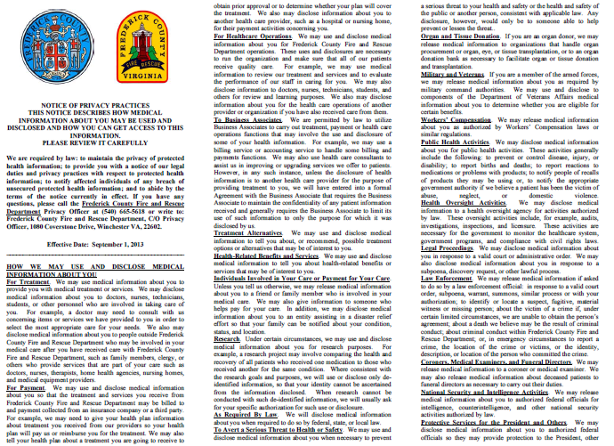

Slide 23
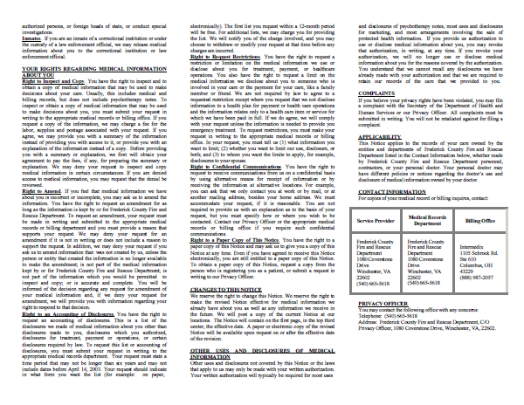

Slide 24
NPP in Emergency Settings
During the emergency treatment of a patient, the NPP must be given as soon as practical as detailed in 45 CFR 164.520 of the privacy rule.
Providers may provide this information after the transfer of patient care at the receiving facility.
This ensures that the provision of this information does not interfere with patient care or become lost during the emergent phase of treatment. If after transfer of care it is still not feasible to present the patient with the NPP, then the EMS Provider may leave it with the assigned nurse to present when it is feasible.

Slide 25

Permitted Disclosures
Disclosure of PHI is acceptable in the following circumstances:
Treatment
Payment
Operations
Public Health Regulations
Victims of Abuse
Judicial Proceedings
Law Enforcement
Births and Deaths
Research
Protection of Public Safety

Slide 26
Treatment, Payment, and Operations
Treatment – giving PHI to other providers involved in patient care, such as the hospital.
Payment – receiving PHI from other providers, as necessary for billing.
Operations – audits, quality assurance assessments.

Slide 27
Public Health Activities
Disclosures to public health authorities, as authorized by State Law.
Also allows for notification of communicable diseases to EMS providers involved in an exposure.

Slide 28
Victims of Abuse, Neglect, and Domestic Violence
The law requires (and HIPAA allows):
Reporting an “endangered adult” believed to be a victim of battery, neglect, or exploitation to Adult Protective Services or law enforcement.
Reporting a child that is believed to be a victim of abuse or neglect to the immediate supervisor, Child Protective Services, or law enforcement.

Slide 29
Judicial Proceedings
Disclosure must only be made when a Judge or Grand Jury orders disclosure through a subpoena or warrant.
**A private attorney does not have the authority to order a provider to discuss a case. If contacted by an attorney, always contact the County’s law office and Privacy Officer for advice before proceeding.**

Slide 30
Law Enforcement
Disclosure of PHI to Law Enforcement is permitted when:
Required by law.
Ordered by a court.
Ordered by Administrative Subpoena.

Slide 31
Law Enforcement
When assisting the police to identify or locate a suspect, missing person, or witness, the provider may release:
Name / Address
Date / Place of Birth
Social Security #
Blood Type
Date / Time of Treatment
Distinguishing characteristics – height, weight, tattoos, scars, etc…

Slide 32
Law Enforcement
Decedents
In the Commonwealth of Virginia local law enforcement is required to respond to any unattended death and will conduct an investigation.
You may request Law Enforcement anytime you feel an attended death is “suspicious” in nature.
You may release PHI to alert law enforcement of a patient’s death, IF the death may have resulted from criminal activity.
You are not required to make a “legal conclusion” that the death resulted from a crime.
Only a “suspicion” is required.
Note: there is a general exception for releasing PHI to coroners and funeral directors for non crime-related deaths.

Slide 33
Law Enforcement
As patient care advocates, EMS Providers
should encourage law enforcement to gain
information directly from the source, when
possible.
Any requests for information regarding the incident should be directed to the Department’s Privacy Officer.

Slide 34
Law Enforcement
Law Enforcement is not a covered entity; therefore the patient still maintains their right to PHI even when in custody. PHI must remain protected unless consent is given.
The patient still has the right to consent to transport as long as they are mentally and physically capable to consent, and sign as such even while in custody.
When releasing a patient to Law Enforcement custody (patient refusing transport to the hospital by ambulance), they are not providing medical care; therefore, we do not share PHI without consent from the patient.

Slide 35
Civil Penalties
The U. S. Department of Health and Human Services may impose civil penalties on a covered entity for failure to comply with a Privacy Rule requirement.
Penalty Tier | Level of Culpability | Minimum Penalty per Violation (2019) | Maximum Penalty per Violation (2019) | New Maximum Annual Penalty (2019)*
1 | No Knowledge | $117 | $58,490 | $1,754,698
2 | Reasonable Cause | $1,170 | $58,490 | $1,754,698
3 | Willful Neglect – Corrective Action Taken | $11,698 | $58,490 | $1,754,698
4 | Willful Neglect – No Corrective Action Taken | $58,490 | $1,754,698 | $1,754,698

Slide 36
Criminal Penalties
A person who knowingly obtains or discloses individually identifiable health information in violation of HIPAA faces a fine of $50,000 and up to one-year imprisonment.
The criminal penalties increase to $100,000 and up to five years imprisonment if the wrongful conduct involves false pretenses, and to $250,000 and up to ten years imprisonment if the wrongful conduct involves the intent to sell, transfer, or use individually identifiable health information for commercial advantage, personal gain, or malicious harm.
Criminal sanctions are enforced by the U. S. Department of Justice.
Pub. L. 104-191; 42 U.S.C. §1320d-6.

Slide 37
HIPAA
Scenario One
You and your partner respond for a neighbor who suffers from depression. You discover during your assessment that the patient has had suicidal thoughts. After the call, you are concerned that other First Responders in your community need to know the extent of the patient’s illness so they can watch for warning signs should the depression deepen.
Can you share what you have learned with you fellow First Responders?

Slide 38
Answer
No, this is a breach of confidentiality.

Slide 39
HIPAA Scenario Two
There is a call in your town. It involves the treatment of an entrapped farmer who subsequently dies from his injuries. You are concerned that a Critical Incident Stress Debriefing might lead to a violation of HIPAA.
Should you be concerned?
?

Slide 40
Answer
No, a Critical Incident Stress Debriefing is held with only those providers involved in the call. The rules of CISM is that everything said at the debriefing is confidential.

Slide 41
HIPAA
Scenario Three
You are in charge of presenting a CE session for the monthly meeting of First Responders. You want to share some of the details of a recent call, but you are concerned you will be in violation of HIPAA because the patient is a resident in your town.
Can you do case review as education? If so, what precautions should you take to protect the patient’

Slide 42
Answer
You can use the details of the call as education as long as you do not give out identifying information such as name, address, etc.

Slide 43
HIPAA
Scenario Four
The First Responders in your fire department routinely use a break room in the station to fill out their paperwork. The room is not secure. How can you ensure that confidentiality is not compromised?
Can you work on paperwork while non-First Responders are in the room?

Slide 44
Answer
If you are working on EMS First Responder paperwork, you need to be sure to put everything away when you are done. Do not leave call reports with confidential information on the table where anyone can pick it up. You can work on paperwork with non-EMS personnel in the room, but do not share the information with them.

Slide 45
HIPAA Scenario 5
You have just assisted with your first field delivery of a newborn. You are so excited you post it on Facebook with pictures from your cell phone. Can you do this and still comply with HIPAA?

Slide 46
Answer
No. Putting information about EMS calls on Facebook is a breech of confidentiality. Even if you use no names it would be very easy in a small community for people to figure out who the mother and child are.

Slide 47
HIPAA Scenario 6
You have transported a suspect (now patient) that is in law enforcement custody. The patient consented to the transport. The officer would like you to provide a copy of your patient care report to him after you finish it so he can review what happened during the transport. Should you give it to him?

Slide 48
Answer
No. The patient still has their rights to their PHI. If the officer requests a copy of the report, he will have to direct it to the Department’s Privacy Officer. This is not your responsibility or duty to provide this information as he is not covered under HIPAA.

Slide 49
Resources
http://www.hhs.gov/ocr/privacy/hipaa/understanding/index.html
http://www.hhs.gov/ocr/privacy/hipaa/understanding/training/index.html
http://www.provena.org/usmc/body_ems.cfm?id=291

Slide 50
Documentation Update
With the constantly changing environment surrounding healthcare, our documentation has come to the forefront.
Globally, we are going to a more patient centered system where all records from pre-hospital, hospital, specialty, and rehabilitation facilities are sharing their information in one patient file.
Our records need to be accurate and complete to provide our patients with the best overall care.
The following slides will review some common errors.

Slide 51
Documentation Update
Remember all calls start at dispatch…why were you called?
Paint a picture from start to finish. From dispatch to on scene, to transferring care at the hospital. Include all details.
Like your mom says “Use your words”
You are trained to use descriptive words like lateral, medial, superior, and inferior, so use those. You also know the difference between a femur and a humerus. Use the proper terminology. When no one term fits, use the best words to describe what you have seen.
All patient’s get an assessment so make sure you detail that assessment in your narrative.
The chief complaint is the main thing the patient is complaining of not what the nursing home staff say the lab values said.
The primary impression is your differential diagnosis not what you were dispatched for.
Mental Status: What is their mental status and is this normal for them.
Signature: Make sure you get the patient’s signature with ALL calls. Only get the staff to sign if the patient is medically or physically incapable.

Slide 52
Documentation Update
Back to basics:
Remember your tools like OPQRST and SAMPLE.
Treatment
How did you treat your patient’s complaint? How did they respond to the treatment? Why did you place the patient on O2 or start an IV, what was the clinical reason?
Transport and Transfer of Care
How did the patient get on the cot? Walk, assisted, full lift? Why couldn’t they walk by themselves?
Who did you transfer your patient to and where?

Slide 53
Documentation Update
Your ImageTrend Report
So you did an awesome narrative that has everything you did but…. you didn’t put anything under procedures and medications. When we run numbers for the statistics or grants, we need that information to show how we are doing as providers. This information must be entered for proper reporting not only by FCFRD but the state requires it as well.
Attachments
EKG: If you place the patient on the monitor you are required to include a copy of the strip. This is considered a part of the patient’s medical record.
Facesheet: You are also required to attach a facesheet whenever possible for each transport. This must be for the correct patient. Attaching a facesheet for the wrong patient is considered a potential HIPAA violation.

Slide 54
Documentation Update
If you receive a notice that your report needs attention, you are required to respond to that request in a timely manner. Your officers will be following up on outstanding reports.
As always if you have a question or need help, we are here to help!
You are some of the best EMS Providers out there…so let’s show people how amazing you are!

Slide 55
Next Step
Complete the quiz on the FCFRD website and click submit.
You must score 70% to pass the training.
If you do not pass you will be allowed one retest.

Slide 56


