Slide 1
Image Trend Training
Adding billing information
2017

Slide 2
Goals
After this training module you will be able to locate the billing information on the hospital face sheet.
You will also understand how to properly add that information to the billing tab in the Image Trend reporting program.

Slide 3
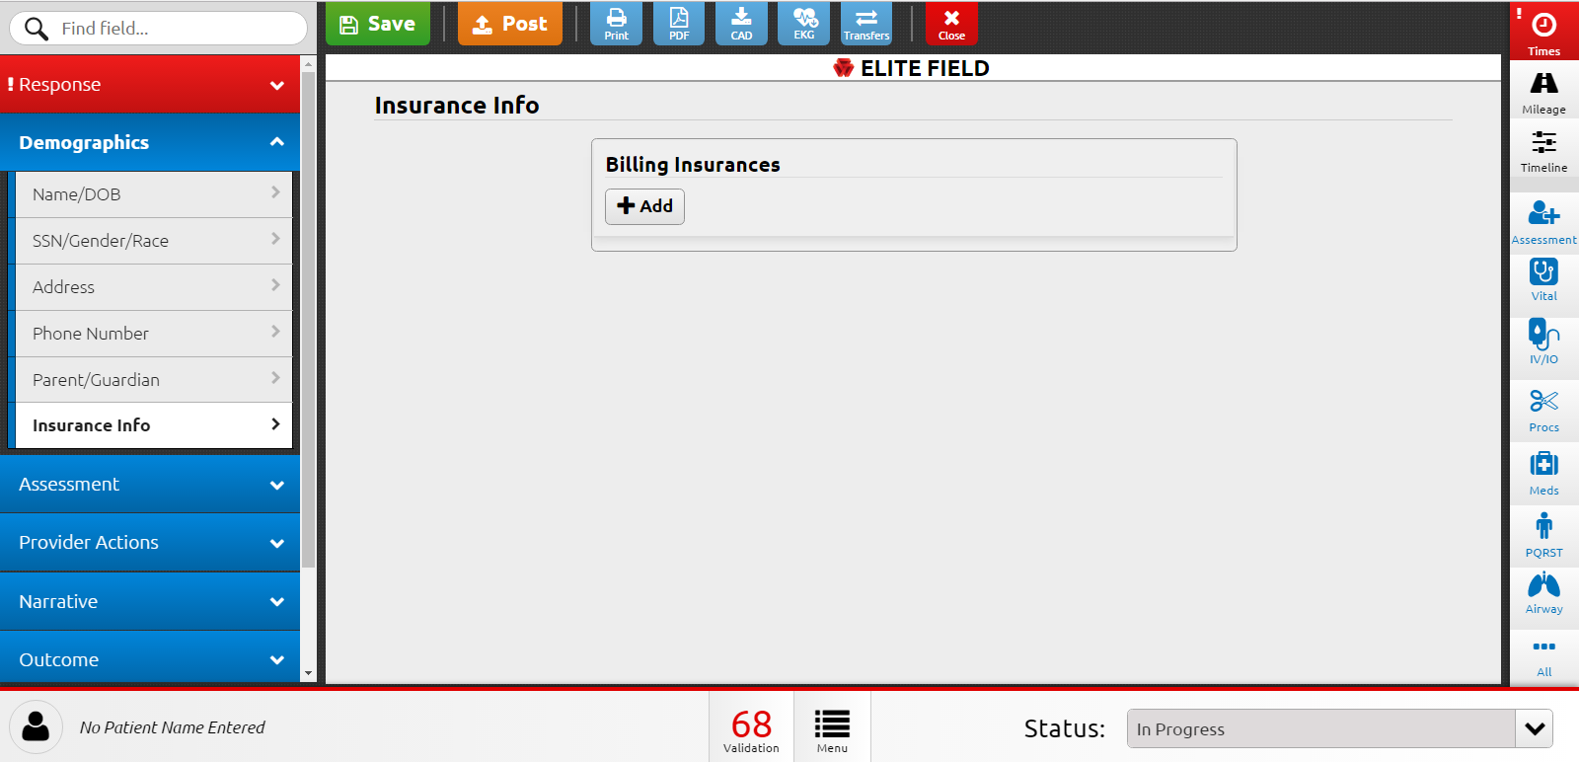
Entering Billing Information
From the demographics menu go to the Insurance Info tab. If the patient has insurance listed on their face sheet click the Add button under the Billing Insurances heading. If no insurance is listed you may leave this information blank and continue with your patient report.

Slide 4
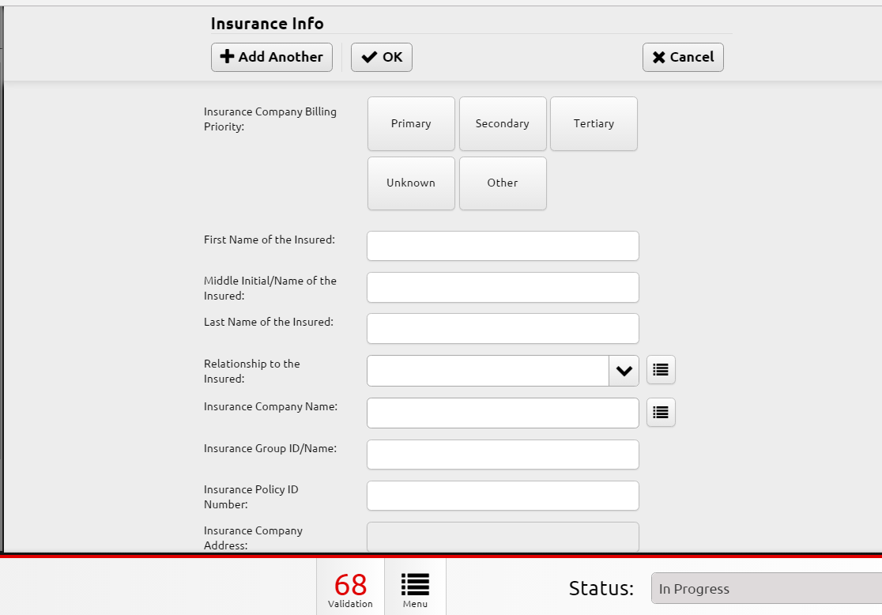
Entering Insurance Information
*Select the billing priority based on what is on the face sheet.
*Enter all highlighted fields if they are available.
*Not all insurance companies will have a group ID. Enter the Group ID if listed on the face sheet.
* When entering the Policy ID make sure to enter all letters and numbers including all available zeros.

Slide 5
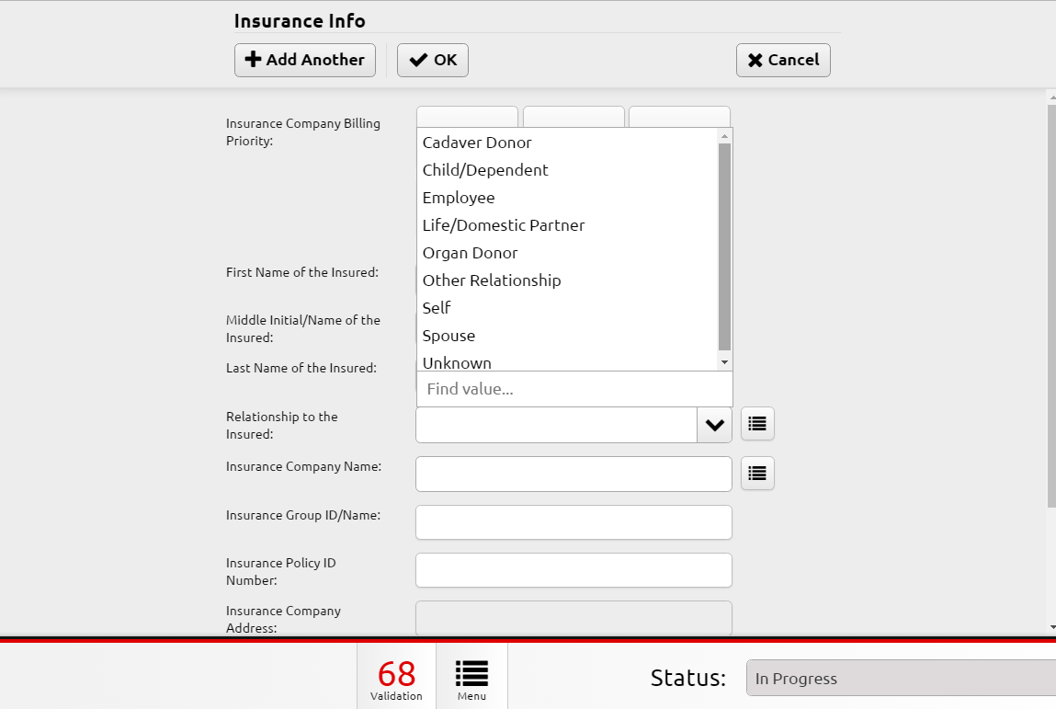
Entering Insurance
*If the relationship to insured is something other than self select the relationship as listed on the face sheet. Enter the first and last name of the subscriber and middle name only if available.
*When all information is entered accurately select OK at the top to save your information. Click add for each additional insurance selecting the appropriate level as listed on the face sheet.

Slide 6
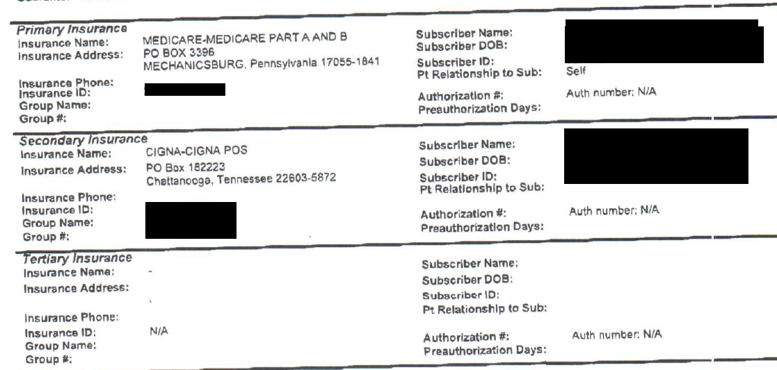
Face Sheet
123456789A
Smith, Bob
R123456789
Spouse
12345
In this example you see the primary and secondary insurance is filled out on the hospital face sheet. Next you will watch a short video of this information being filled out. Policy and group numbers are made up for this example.

Slide 7
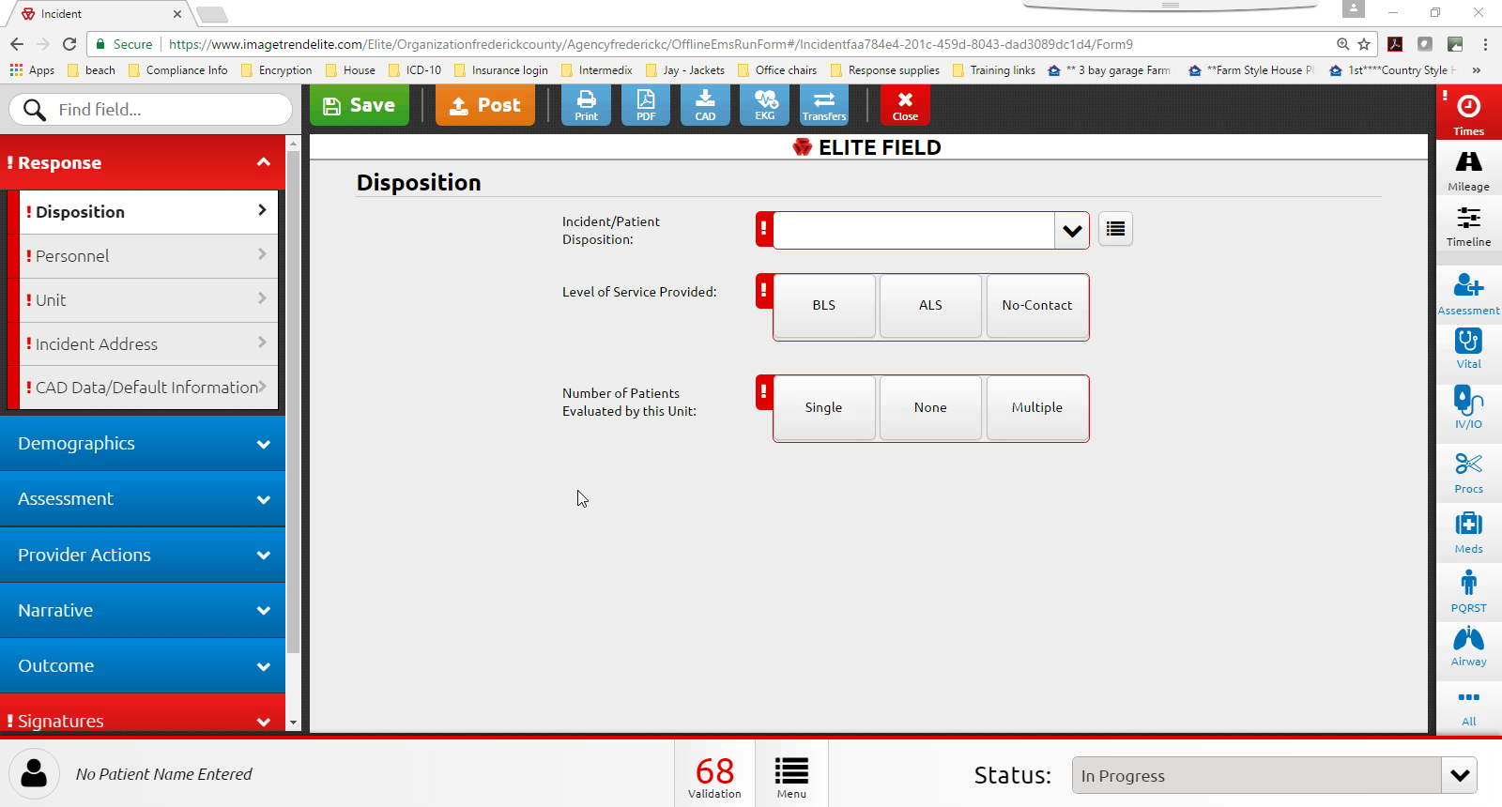

Slide 8
Questions??? Contact: Chrissy Bauserman 540-665-5618 or cbauserm@fcva.us

